Slide 1

Course No. 174328423
Summer Seminar – 2026
FPD – N.D. Tex.

Slide 2
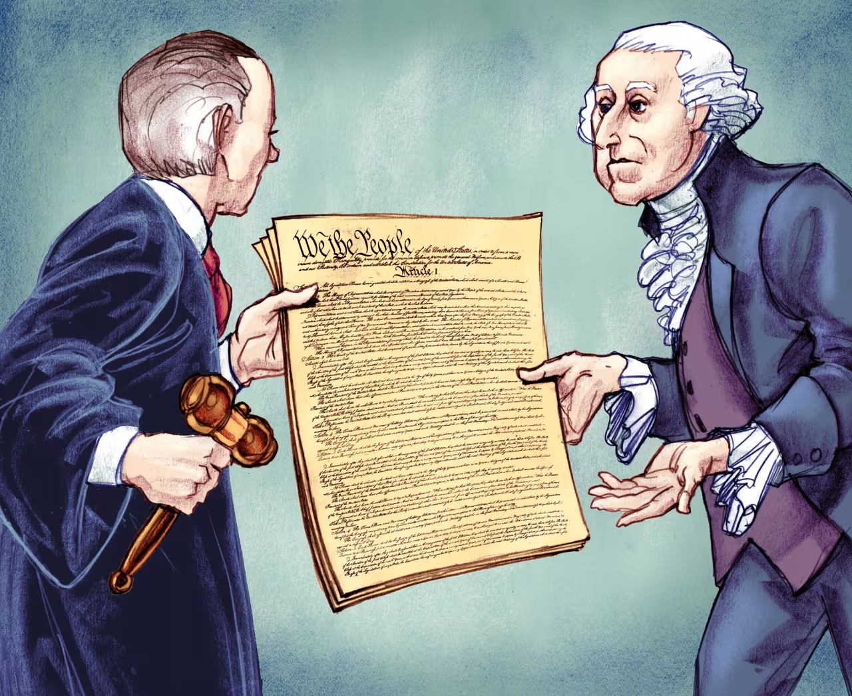
OTGO
Originalism for the People

Slide 3
Goals?
Understand Law
Understand Resources
Recognize Opportunities

Slide 4
The Second Amendment
A well regulated Militia, being necessary to the security of a free State, the right of the people to keep and bear Arms, shall not be infringed.

Slide 5
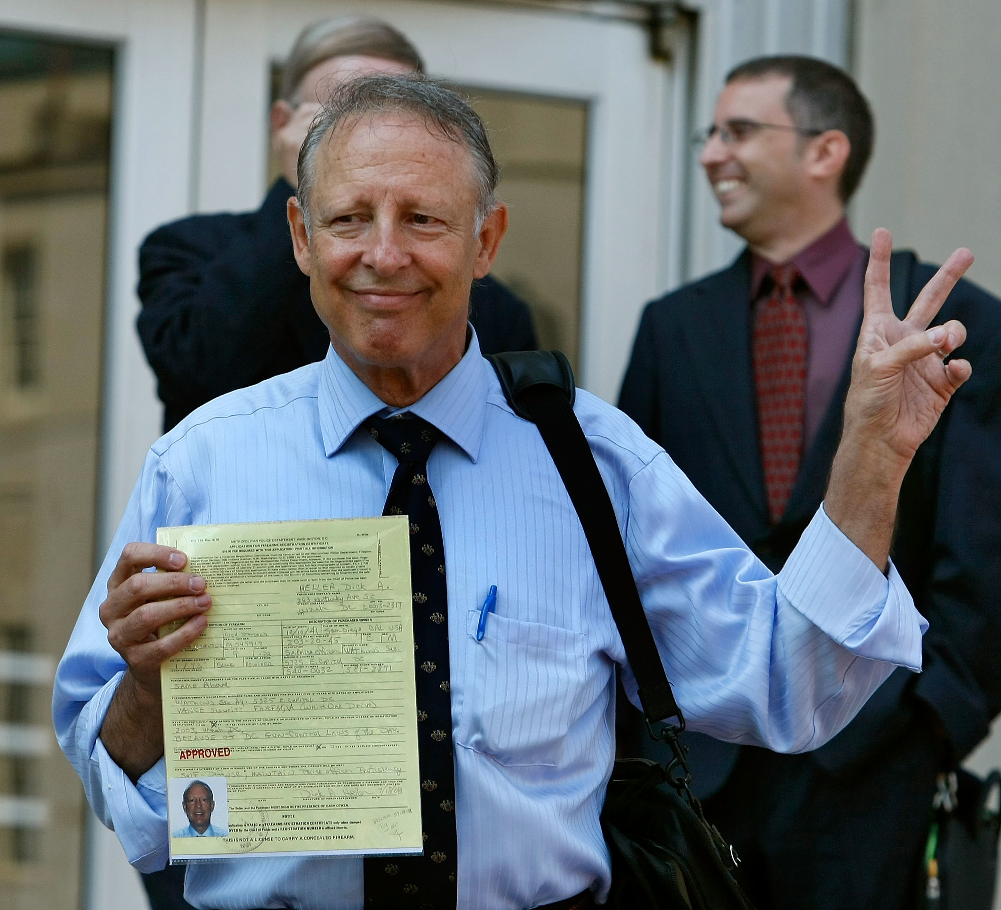
  D.C. v. Heller, 554 U.S. 570 (2008)
Focus on the Text
  The right to keep and bear arms belongs to “the people.”
  “Arms” referred to all weapons, not just those designed for military use.
  The Second Amendment’s prefatory clause announced the Second Amendment’s purpose but does not suggest that preserving the militia was the only reason Americans valued the right to keep and bear arms.

Slide 6
The Second Amendment
A well regulated Militia, being necessary to the security of a free State, the right of the people to keep and bear Arms, shall not be infringed.

Slide 7
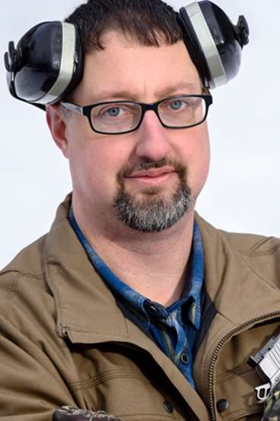
  NYSRPA v. Bruen, 597 U.S. 1 (2022)
Introducing Step Two
  Under the common law, individuals could not carry deadly weapons in a manner likely to terrorize others.
  Similarly, although surety statutes did not directly restrict public carry, they did provide financial incentives for responsible arms carrying.
  Last, States could lawfully eliminate one kind of public carry—concealed carry—so long as they left open the option to carry openly.

Slide 8
The Second Amendment
A well regulated Militia, being necessary to the security of a free State, the right of the people to keep and bear Arms, shall not be infringed.

Slide 9
Bruen’s Two-step Test
(1) – When the Second Amendment’s plain text covers an individual’s conduct, the Constitution presumptively protects that conduct.
(2) – To justify its regulation, the government may not simply posit that the regulation promotes an important interest. Rather, the government must demonstrate that the regulation is consistent with this Nation’s historical tradition of firearm regulation.

Slide 10
Doing Step One Well

Slide 11
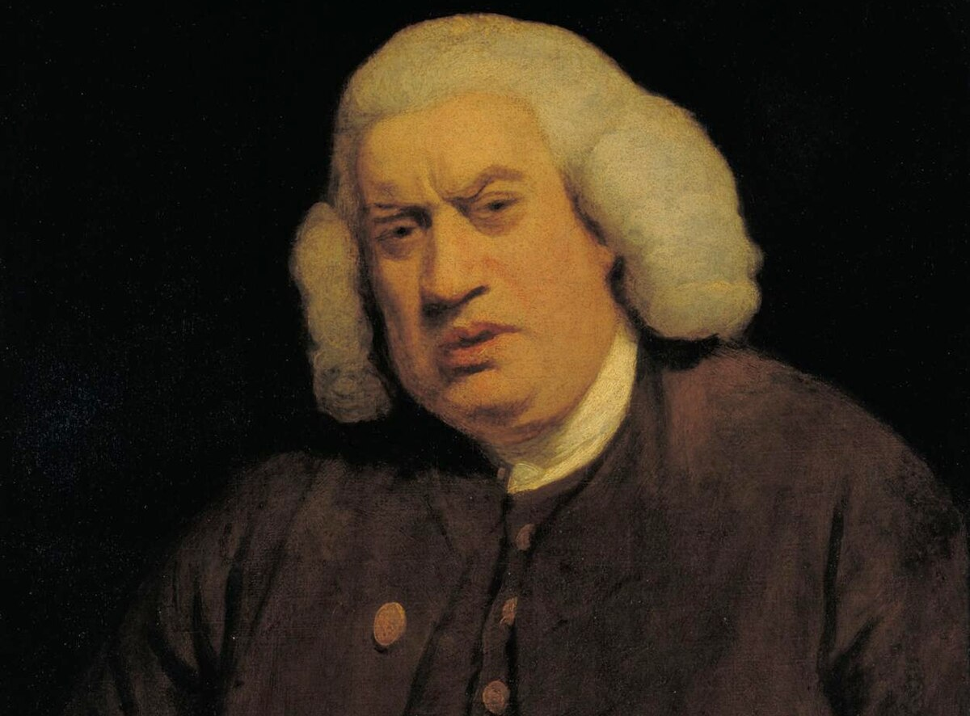
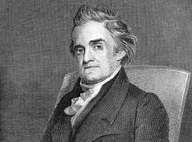
Online Resources
Samuel Johnson, A Dictionary of the English Language (1st ed. 1755)
Samuel Johnson, A Dictionary of the English Language (4th ed. 1773)
Noah Webster, An American Dictionary of the English Language (1828)

Slide 12
The “People”
  Samuel Johnson’s Dictionary
  “A nation; these who compose a community.”
  “A nation; these who compose a community. In this sense is read peoples.”
Noah Webster’s Dictionary
  “The body of persons who compose a community, town, city or nation.”

Slide 13
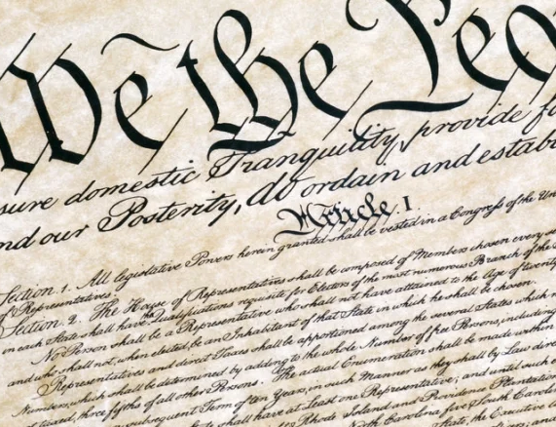
More from Noah Webster
“We say, the people of a town; the people of London or Paris; the English people In this sense, the word is not used in the plural, but it comprehends all classes of inhabitants, considered as a collective body, or any portion of the inhabitants of a city or country.”

Slide 14
“Arms”
  Samuel Johnson’s Dictionary
  “Weapons of offence, or armour of defence.”
Noah Webster’s Dictionary
  “Weapons of offense, or armor for defense and protection of the body.”
  “In law, arms are any thing which a man takes in his hand in anger, to strike or assault another”

Slide 15
Is there a conflict?

Slide 16
“Keep”
  Samuel Johnson’s Dictionary
  “To retain; not to lose.”
  “To have in custody.”
  “To preserve; not to let go.”
Noah Webster’s Dictionary
  “To hold; to retain in one’s power or possession; not to lose or part with; as, to keep a house or a farm; to keep any thing in the memory, mind or heart.”
  “To have in custody for security or preservation.”

Slide 17
“Bear”
  Samuel Johnson’s Dictionary
  “To convey or carry.”
  “To carry as in show.”
Noah Webster’s Dictionary
  “To carry; to convey; to support and remove from place to place; as, ‘they bear him upon the shoulder;’ ‘the eagle beareth them on her wings.’”
  “To wear; to bear as a mark of authority or distinction; as, to bear a sword, a badge, a name; to bear arms in a coat.”

Slide 18
Is there a conflict?

Slide 19
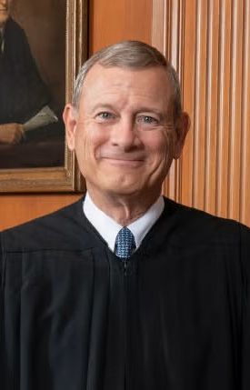
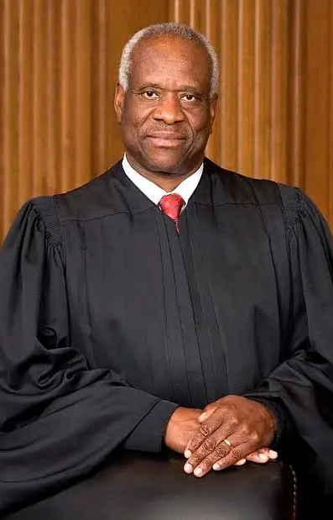
Why bother?
Sec. 922(g)(1) will get before the Supreme Court eventually.
The Supreme Court will address whether felons are among “the people.”
Other laws are subject to similar challenges.

Slide 20
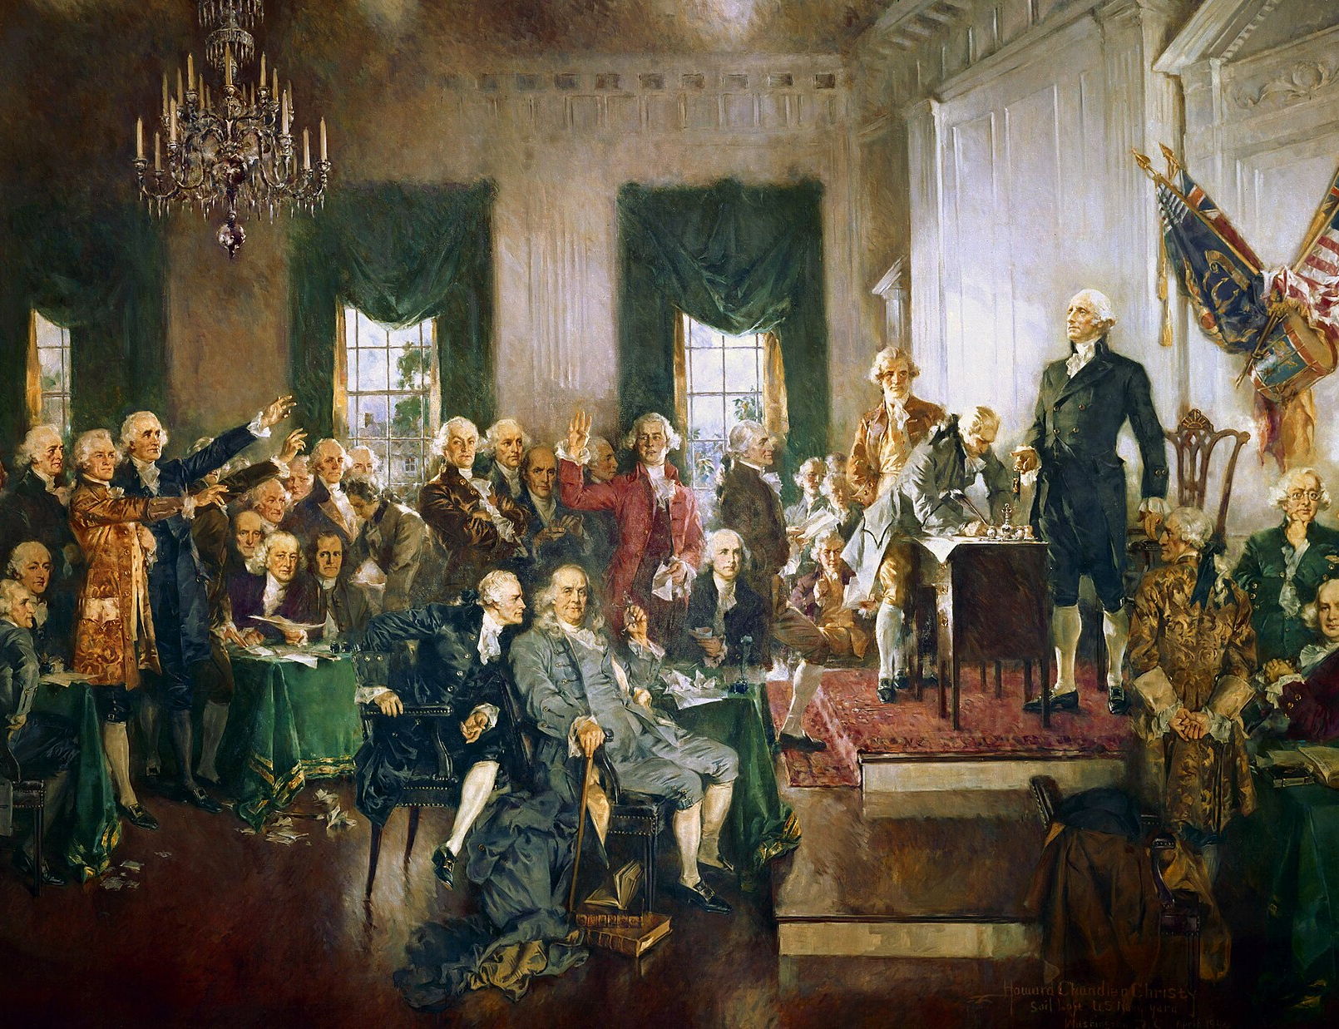
Thank you!
T.W. Brown
(214) 673-6769
Taylor_W_Brown@fd.org

Slide 21
Course No. 174328423
Summer Seminar – 2026
FPD – N.D. Tex.

