Slide 1

Course No. 174328423
Summer Seminar – 2026
FPD – N.D. Tex.

Slide 2
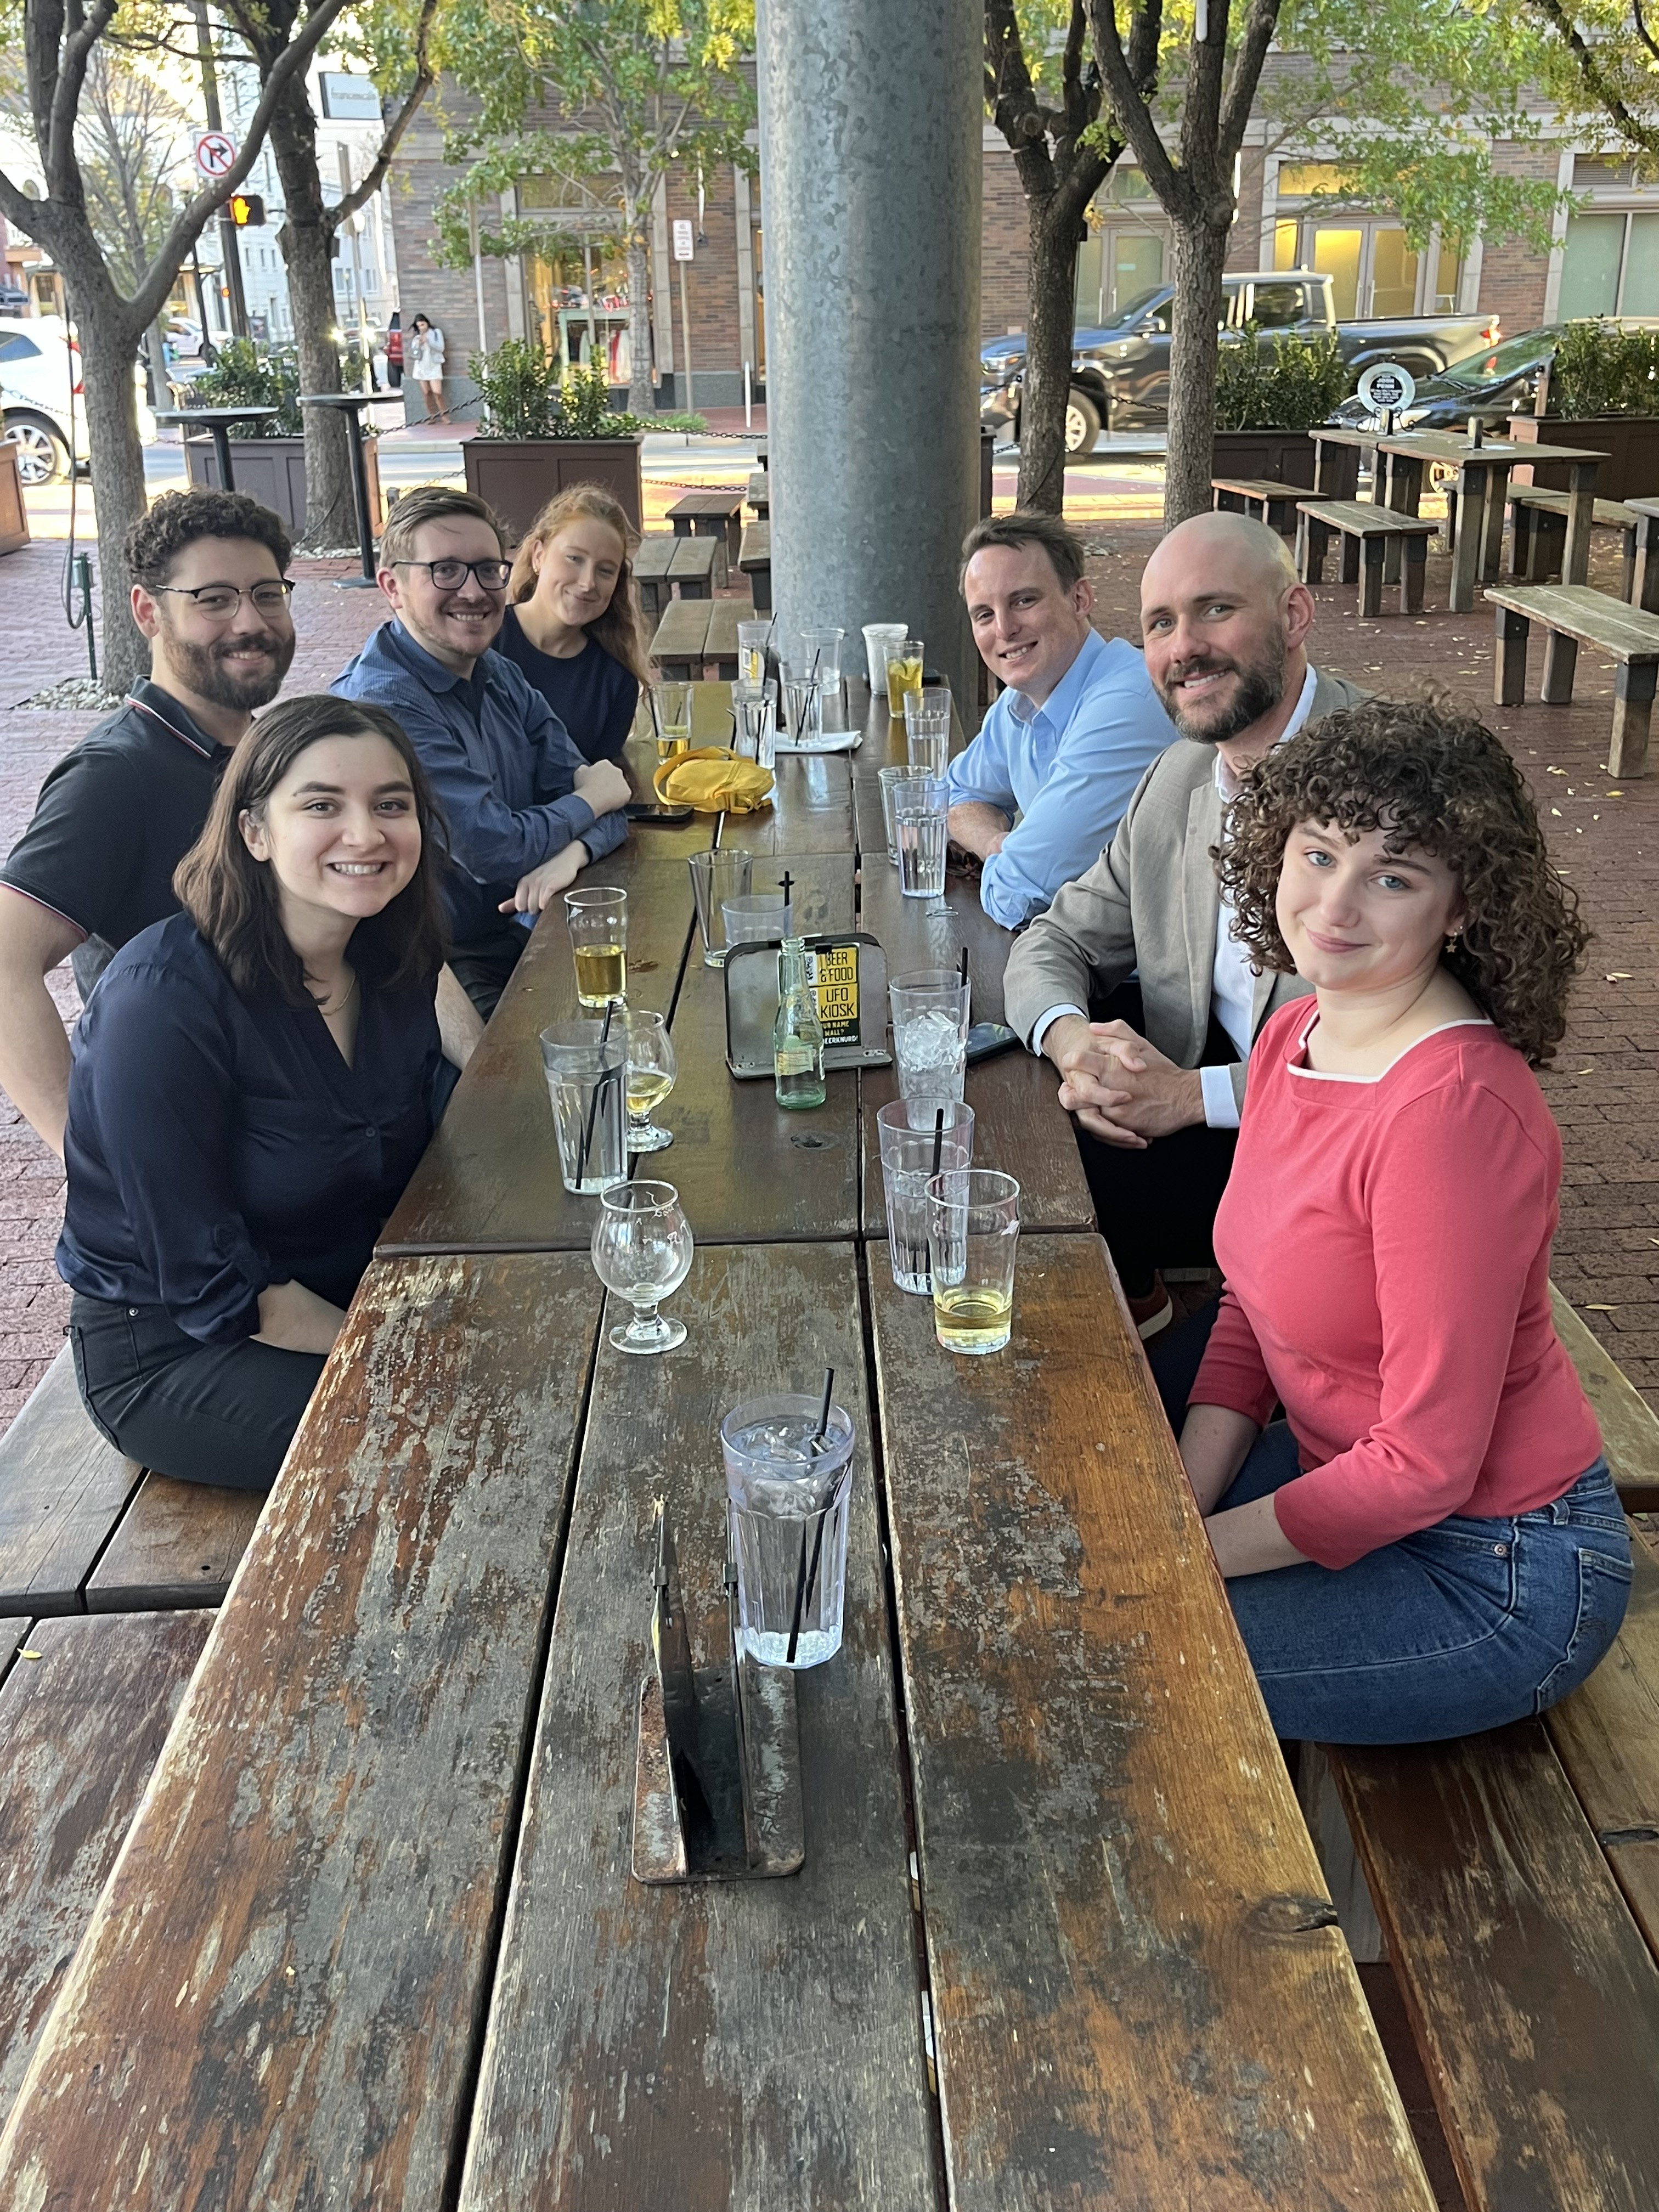
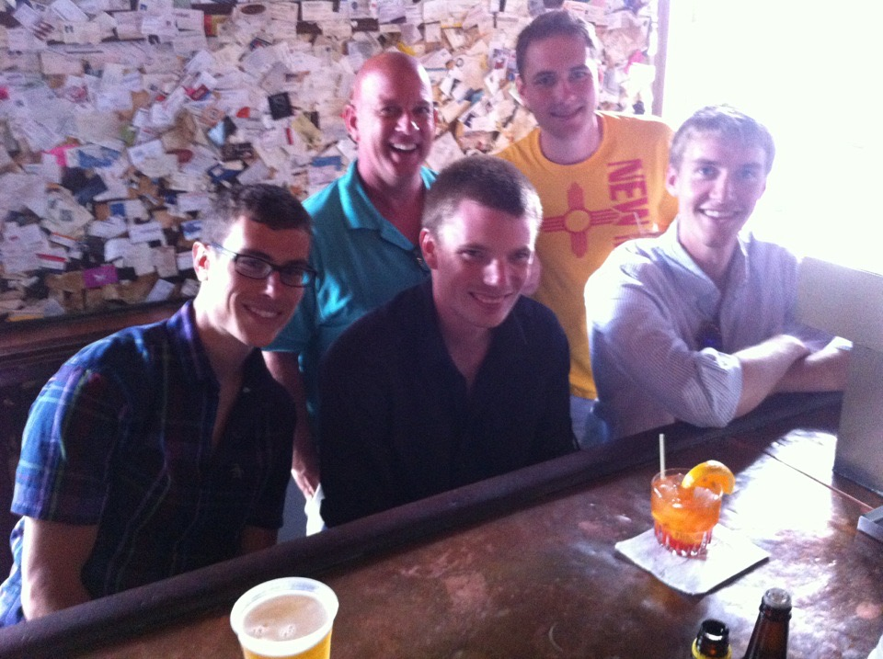
Mentoring Minute No. One: Finding Mentees

Slide 3
Goals
Why?
How?
When?

Slide 4
Why bother?
Pay it forward.
1
Shape the next generation (in your own image).
2
Allow the next generation to shape you.
3

Slide 5
How to find mentees?
Cecily Becker
Texas A&M School of Law
cbecker@law.tamu.edu
Nasser Siadet
SMU Dedman School of Law
nsiadat@smu.edu
Andrea Downes
UNT Dallas College of Law
Angela.Downes@untdallas.edu

Slide 6

When?
Whenever!

Slide 7
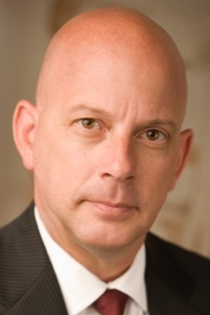
How to be a (good) mentor?
WWJD
  Genuine interest
  Treat your mentee like a lawyer
  Substantive work and feedback

Slide 8
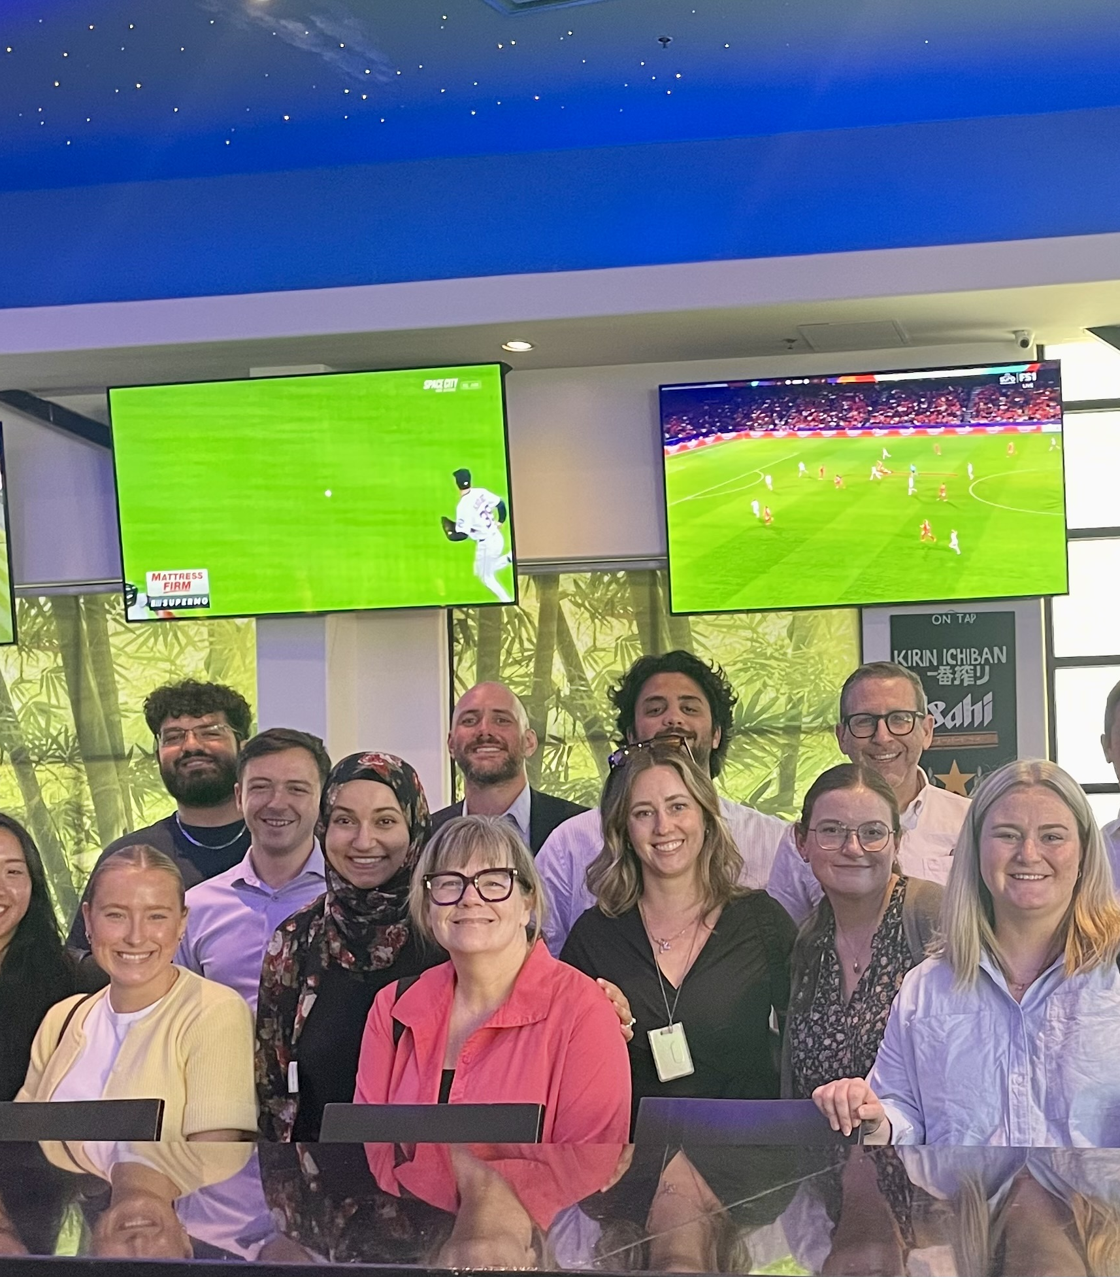
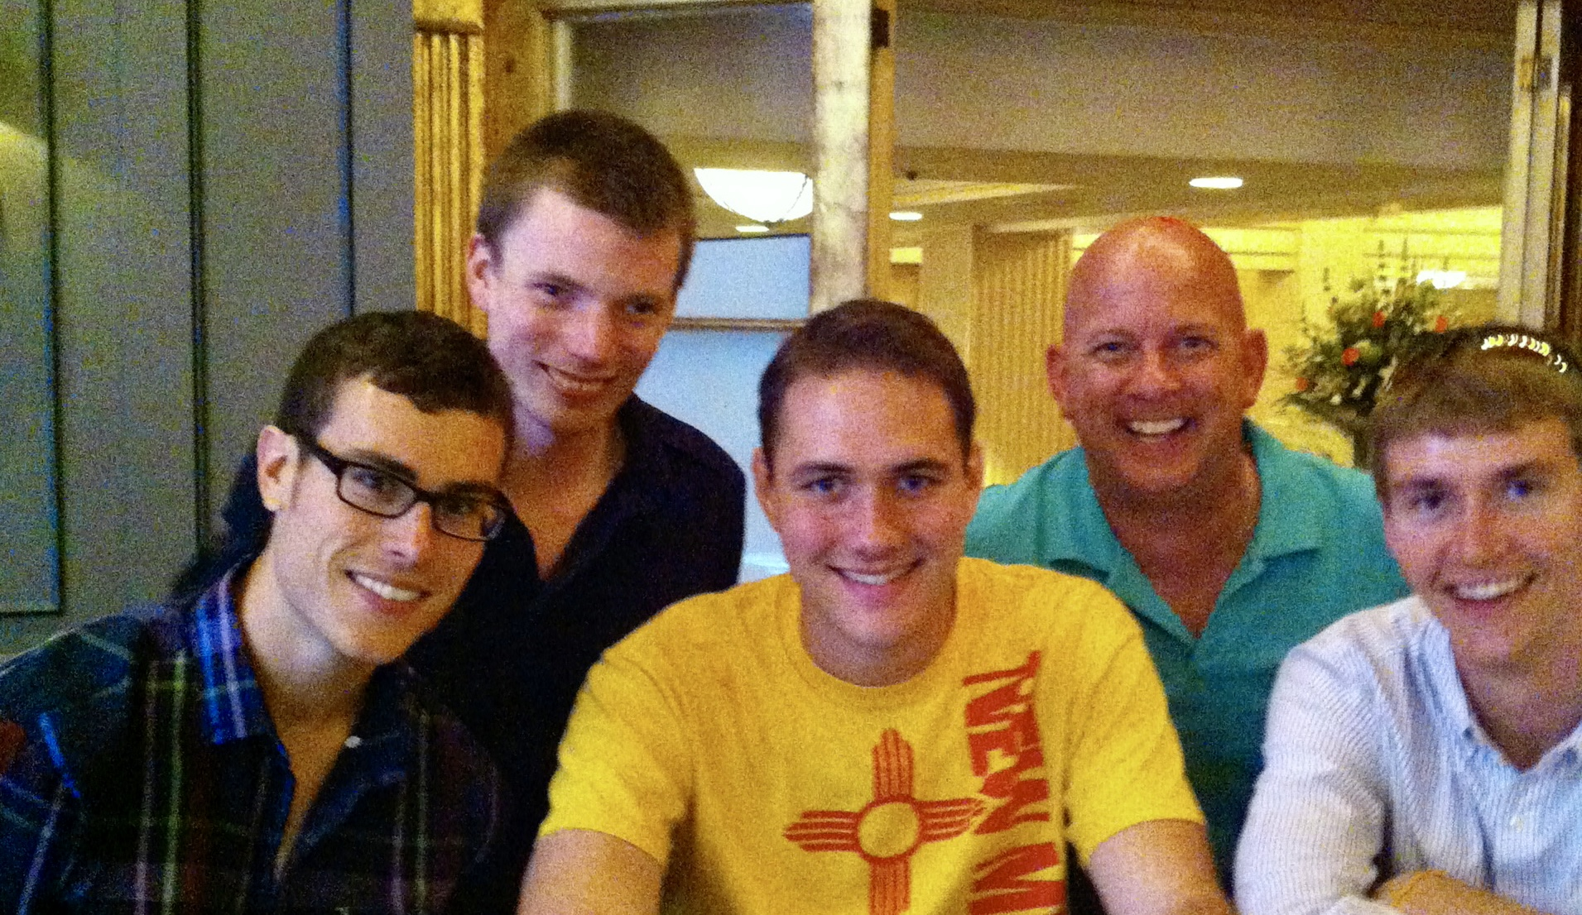
Thank you!
T.W. Brown
(214) 673-6769
Taylor_W_Brown@fd.org

Slide 9
Course No. 174328423
Summer Seminar – 2026
FPD – N.D. Tex.

