Slide 1

Course No. 174328423
Summer Seminar – 2026
FPD – N.D. Tex.

Slide 2

Ethical Internships 101

Slide 3
Agenda
Rules
Real-world Cases
Best Practices

Slide 4
The Basic Rule
“A lawyer having direct supervisory authority over the nonlawyer shall make reasonable efforts to ensure that the person’s conduct is compatible with the professional obligations of the lawyer.”
  Confidentiality of Information
  Conflict(s) of Interest
  Meritorious Claims and Contentions
Subject to discipline?
  Ordered, encouraged, or permitted the behavior?
  Knowingly fails to take reasonable remedial action to avoid or mitigate consequences?

Slide 5
Confidentiality 101
Basis?
1
Scope?
2
Reasonable efforts?
3

Slide 6

Keeping Secrets

Slide 7
Conflicts 101
Current clients?
Former clients?
Imputation?

Slide 8

Comparing Notes

Slide 9
Frivolity 101
Definition?
1
Changes to the law?
2
Defensive posture?
3

Slide 10
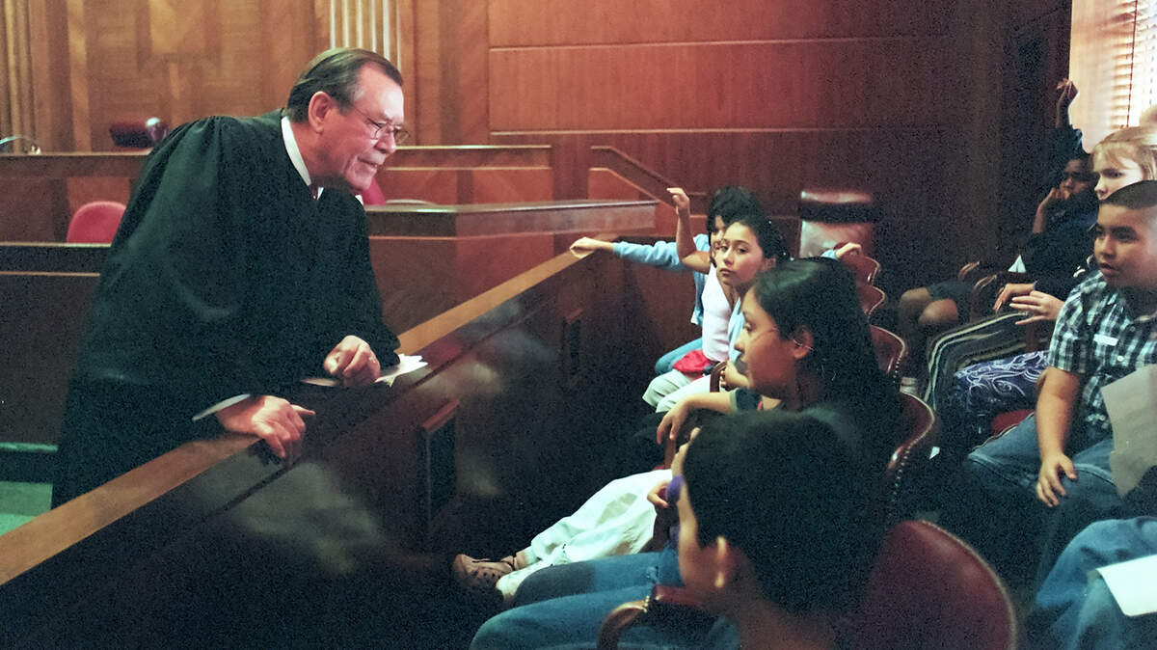
Avoiding Contempt

Slide 11
Simplifying Ethics
“A lawyer having direct supervisory authority over the nonlawyer shall make reasonable efforts to ensure that the person’s conduct is compatible with the professional obligations of the lawyer.”
  Confidentiality of Information
  Conflict(s) of Interest
  Meritorious Claims and Contentions
Subject to discipline?
  Ordered, encouraged, or permitted the behavior?
  Knowingly fails to take reasonable remedial action to avoid or mitigate consequences?

Slide 12
Thank you!
T.W. Brown
Taylor_W_Brown@fd.org
(214) 673-6769

Slide 13
Course No. 174328423
Summer Seminar – 2026
FPD – N.D. Tex.

