Slide 1
Trying a Multi-Defendant Federal Case
• ~ 60 minutes
• Case Study: U.S. v. Cameron Arnold et al. (N.D. Texas)
• Theme: Individual advocacy while playing as a team inside a group trial.
Rachel M. Taft
Christopher J. Weinbel
Federal Public Defender’s Office- NDTX

Slide 2
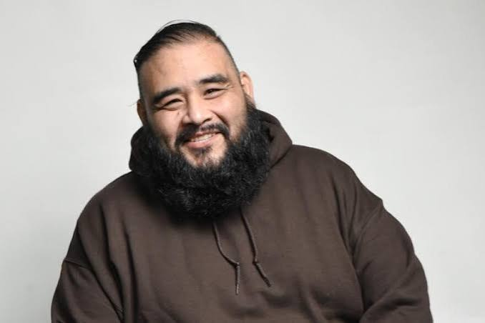
Why These Cases Are Different
One courtroom; multiple defense theories.
Every witness affects every defendant differently.
Defense counsel must monitor every examination for very specific things.
Notes:
Chris- Intro

Slide 3
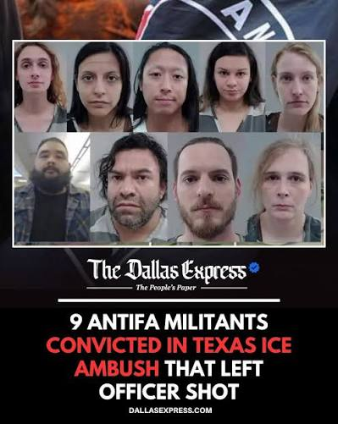
Pretrial motions
Trial
Rule 29
Verdict
Post-trial.
Notes:
Chris intro

Slide 4
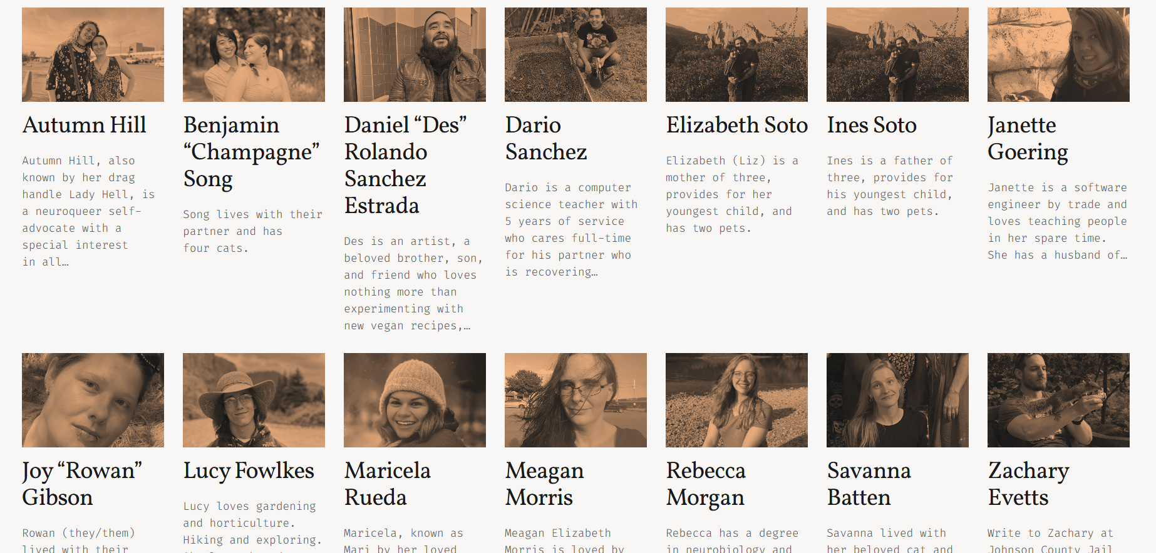
Cast of characters
Government
Defense
Shawn Smith
Frank Gatto
1. Autumn Hill: Cody Cofer, James Luster
2. Zachary Evetts: Patrick McLain, Brian Bouffard, Brad Sauer
3. Benjamin Song: Phillip Hayes
4. Savanna Batten: Christopher Tolbert
5. Bradford/Meagan Morris: Warren St. John, Miles Brissette
6. Maricela Rueda: MarQuetta Clayton, Lesa Pamplin
7. Elizabeth Soto: Harmony Schuerman, Blake Burns
8. Ines Soto: Leigh Davis
9. Daniel Sanchez-Estrada: Christopher Weinbel, Rachel Taft
Notes:
Rachel, highlight people and roles transition to Chris example of Rueda changing

Slide 5

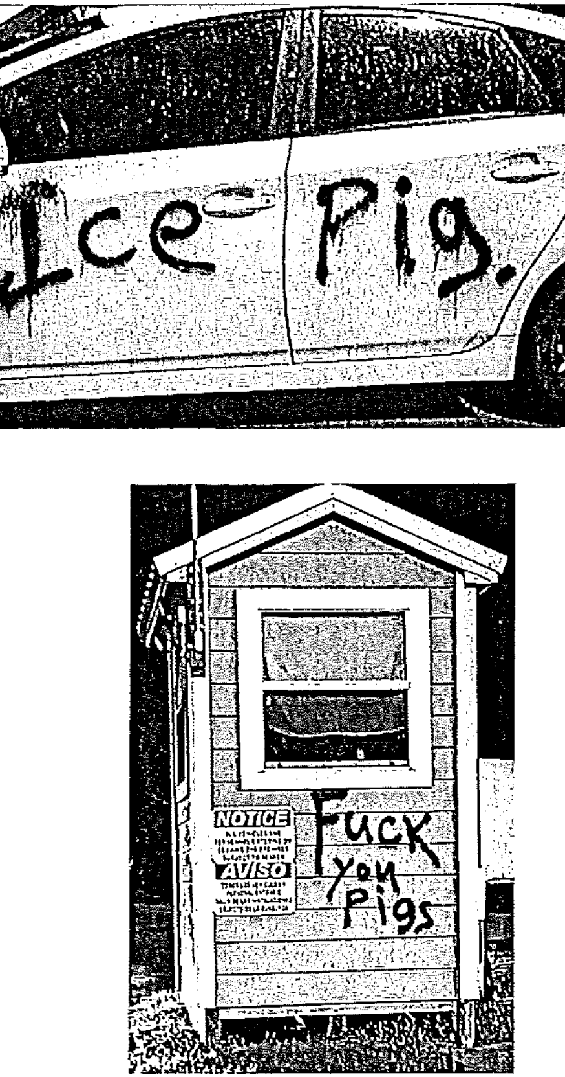
1. Diverging Defense Theories
• Theories evolve as discovery and testimony unfold.
• Your client may become strategically isolated.
• Adjust openings, cross, and closing accordingly.
Notes:
Chris

Slide 6
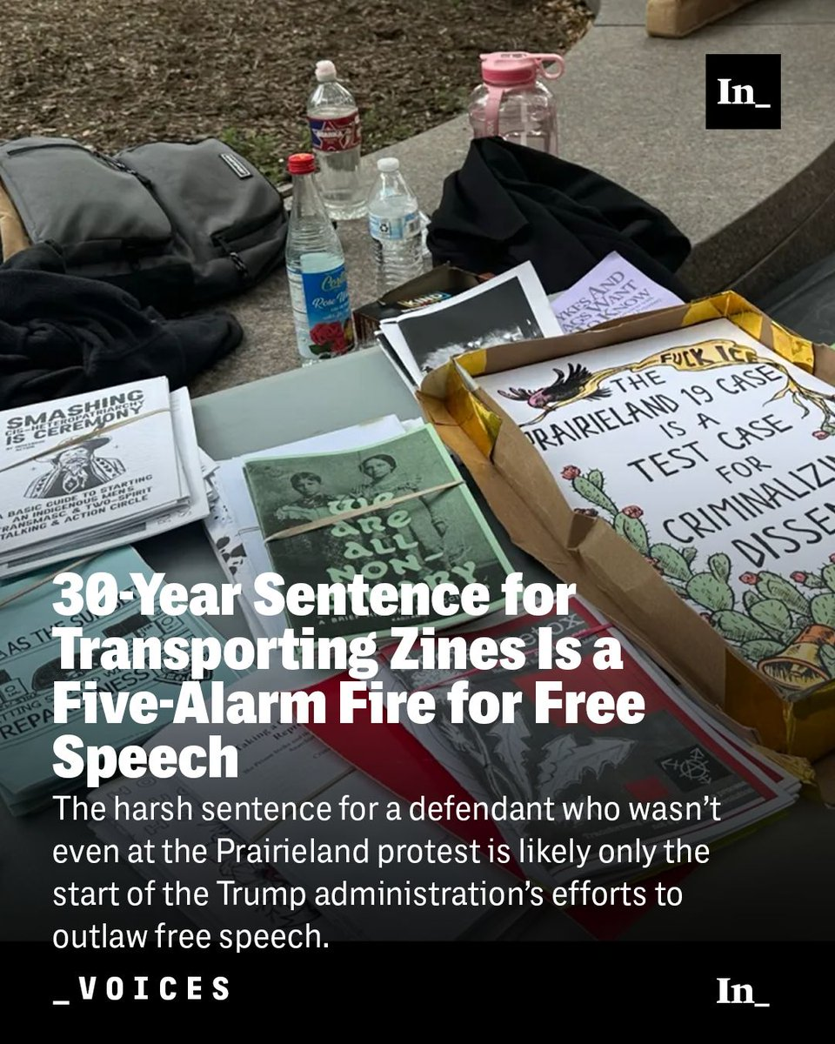
Decision Tree
Does a co-defendant's theory help, hurt, or not affect your client?
If hurt: object, distinguish, or seek limiting instruction.
Evaluate effect on case
Notes:
Chris

Slide 7
Evidence Attribution
• What the jury hears may be different than what may be considered against your client.
• Reinforce this theme in voir dire, opening, and closing.
Notes:
Chris

Slide 8
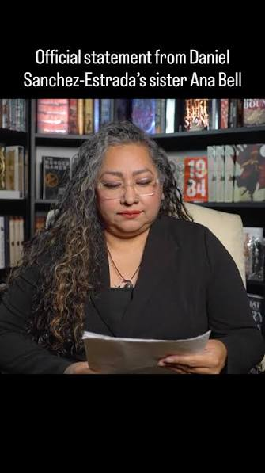
2. Spillover Prejudice
Jurors hear everything.
Not every exhibit or witness applies equally.
Continuously individualize your client.
Notes:
Rachel

Slide 9
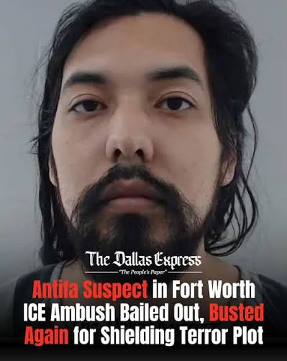
3. When One Defendant Hurts Another
Blame shifting.
Cross-examinations.
Admissions.
Different appellate incentives.
Notes:
Rachel

Slide 10

Bruton & Confrontation
Confessions implicating co-defendants.
Redaction, exclusion, severance.
Bruton v. United States, 391 U.S. 123 (1968), is a 1968 United States Supreme Court ruling in which the Court held that a defendant was deprived of his rights under the Confrontation Clause if a confession by his codefendant was introduced in their joint trial, regardless of whether the jury received instructions only to consider it against the confessor. This has become known as the Bruton rule.
Notes:
Rachel

Slide 11
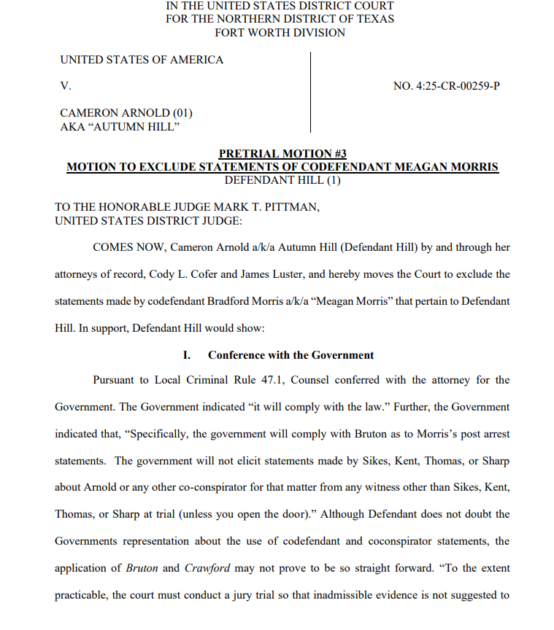
A statement is sufficiently redacted if it eliminates all specific identification of the defendant, such as his or her proper name or nickname, as well as all references to his or her existence. Richardson, 481 U.S. at 211. As a categorical rule, merely replacing the defendant’s name with a blank space or the word “deleted” is not a sufficient redaction. Gray 523 U.S. at 192-97. This approach is deficient because such an obvious modification essentially refers directly to the non-confessing defendant. Gray, 523 U.S. at 192-97
Notes:
Rachel

Slide 12
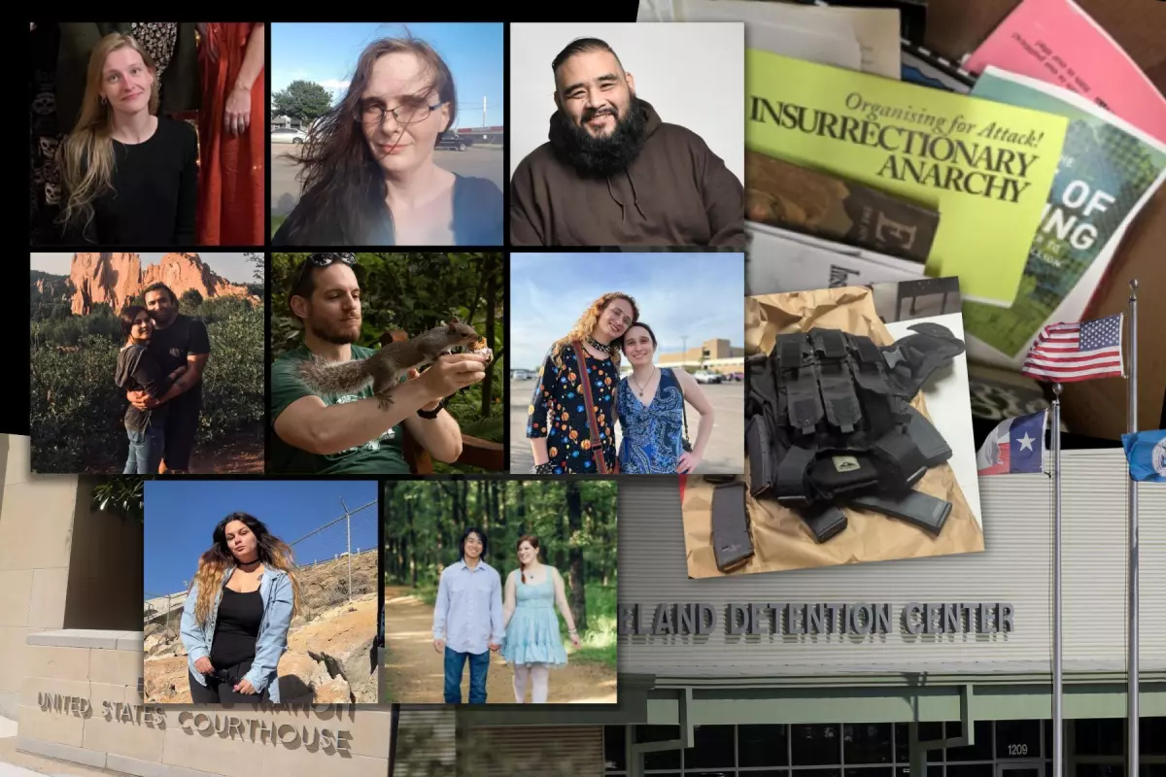
4. Coordinating Strategy
• Benefits of joint work.
• Limits imposed by ethics and client interests.
• Joint Defense Agreements.
Notes:
Chris

Slide 13
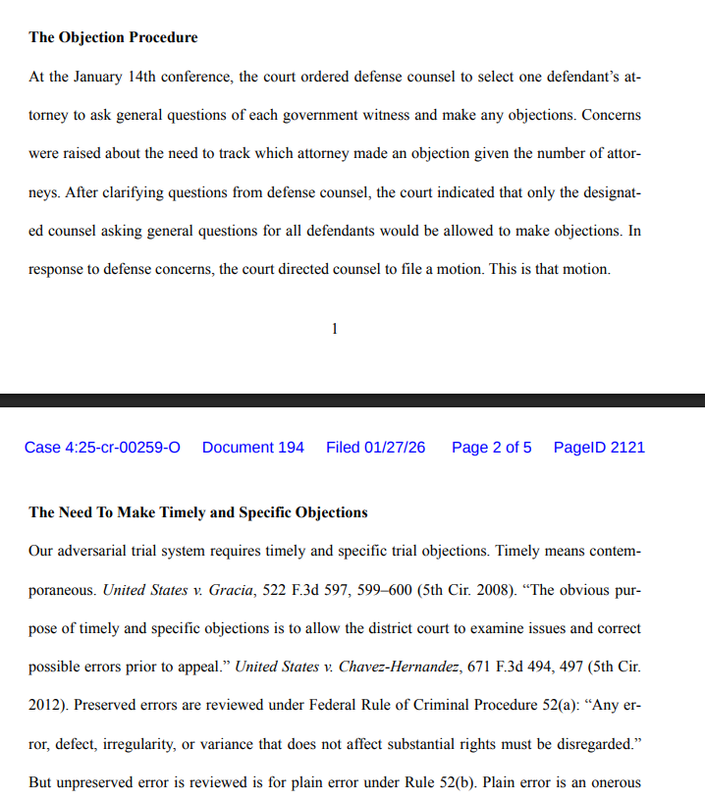
Notes:
Chris

Slide 14
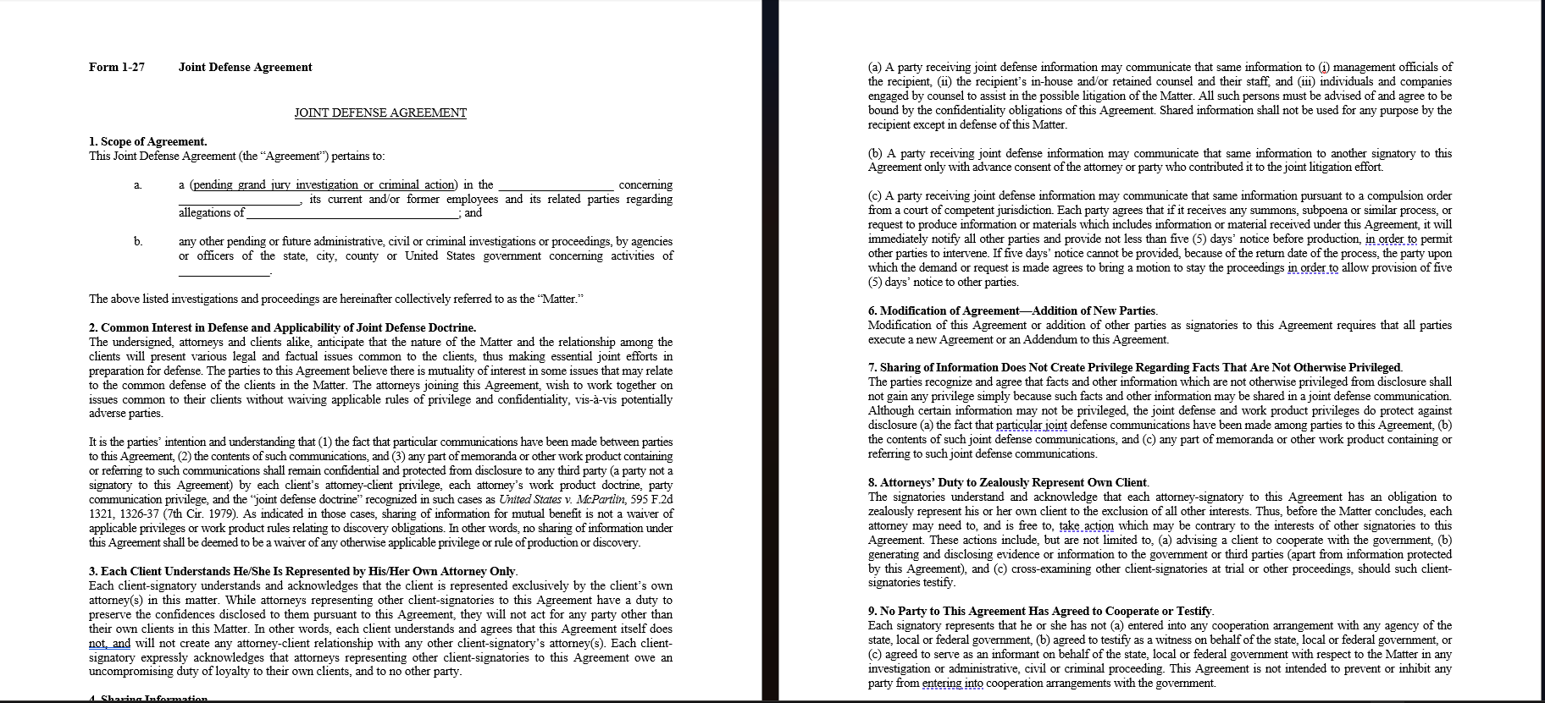
Joint Defense Agreement
Notes:
Chris

Slide 15
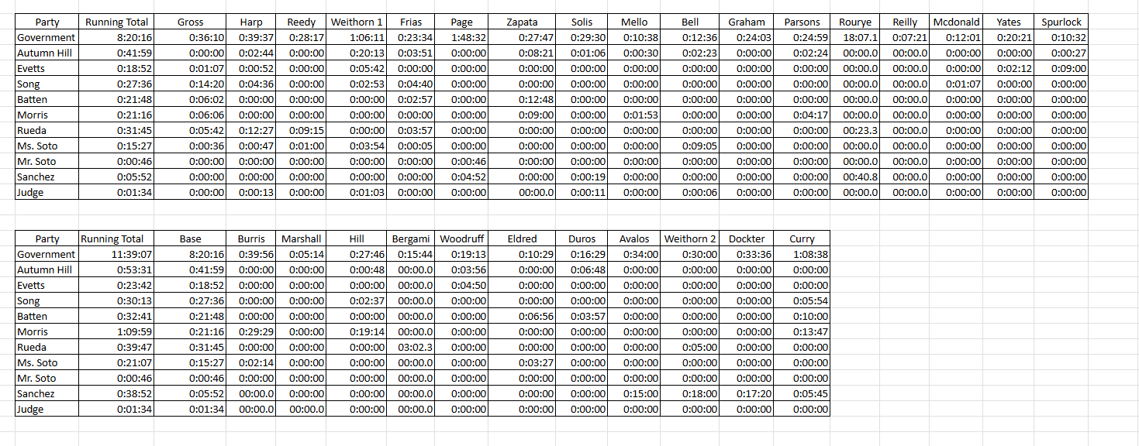
Notes:
Chris

Slide 16
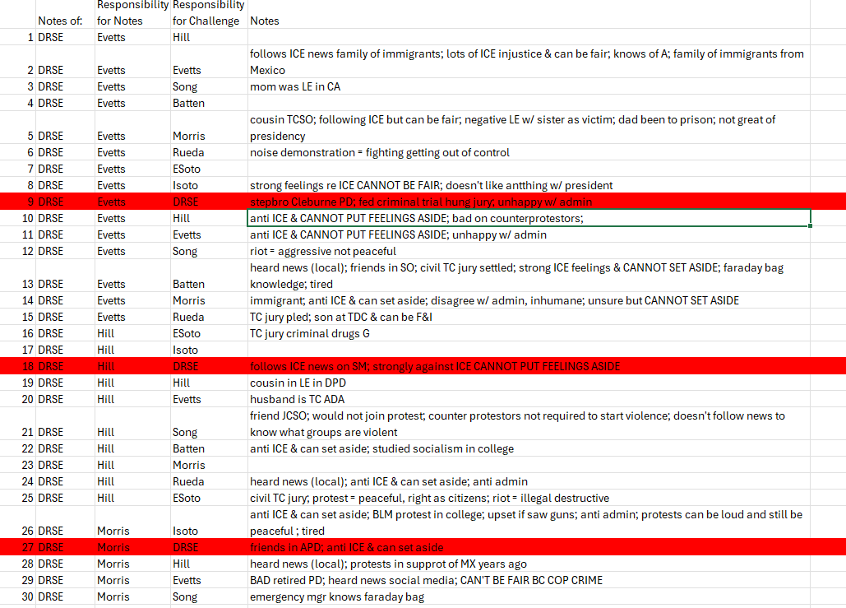
Notes:
Rachel

Slide 17
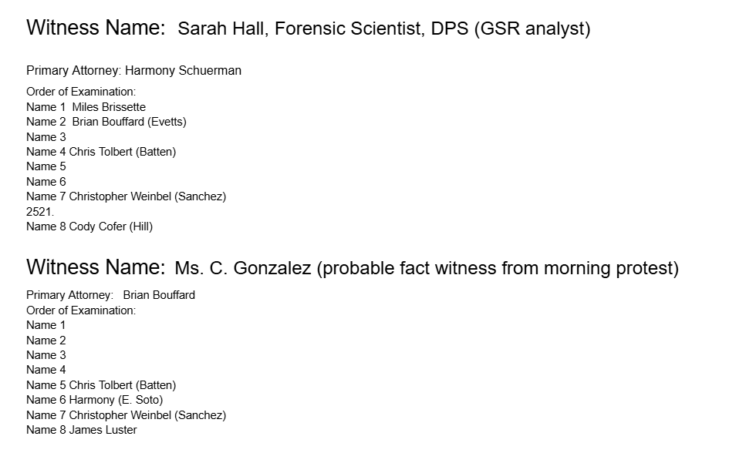
Notes:
Rachel

Slide 18
Rules & Authorities
Rule 8 (Joinder)
  The government can charge a single defendant with multiple offenses in the same case (in separate counts) if the crimes charged are: Of the same or similar character (e.g., a series of similar frauds or robberies)Based on the same act or transaction, Connected to, or constituting parts of, a common scheme or plan.
  Two or more defendants can be charged together in the same case if they are alleged to have participated in the same act or transaction. The same series of acts or transactions (often utilized in conspiracy or joint enterprise cases)Under Rule 8(b), all defendants do not need to be charged in every single count. If a defendant believes that being tried alongside others or having multiple offenses joined will cause unfair prejudice, they typically file a motion to sever under Rule 14.
• Rule 14 (Severance)
  Acts as a safeguard against this by allowing the court to: Order separate trials for different criminal counts. Sever defendants' trials so they are tried individually rather than together.
Notes:
Chris

Slide 19
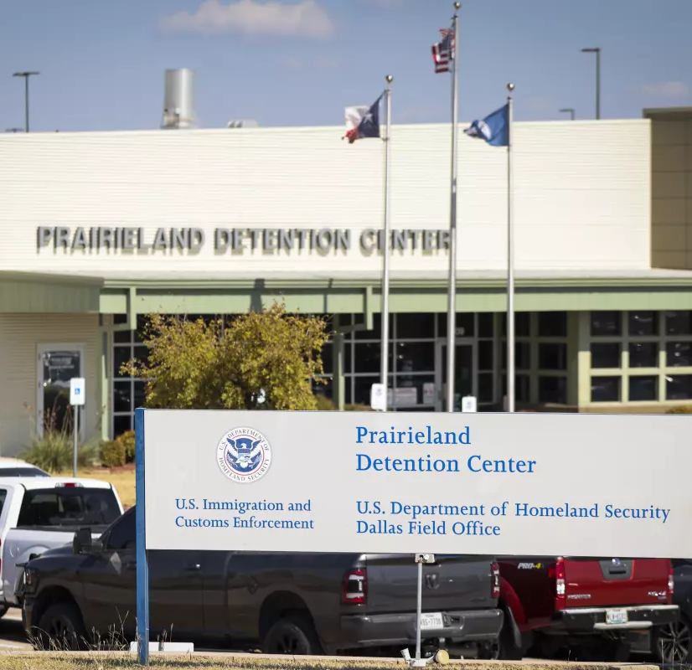
Voir Dire
Combat guilt by association
Test willingness to compartmentalize evidence
Explore attitudes about multiple defendants
Team work extends to voir dire
Notes:
Chris

Slide 20
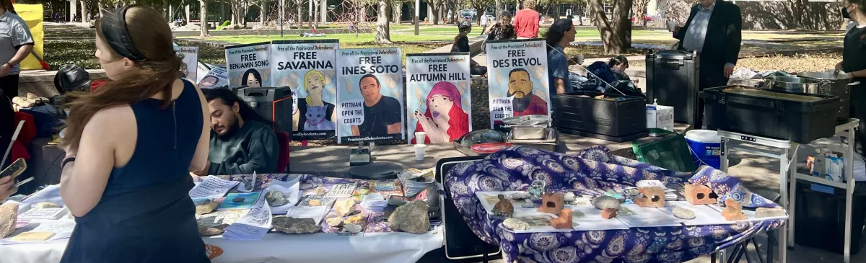
Opening Statement
Give the jury a map focused only on your client.
Do not promise what you cannot deliver.
Notes:
Rachel

Slide 21
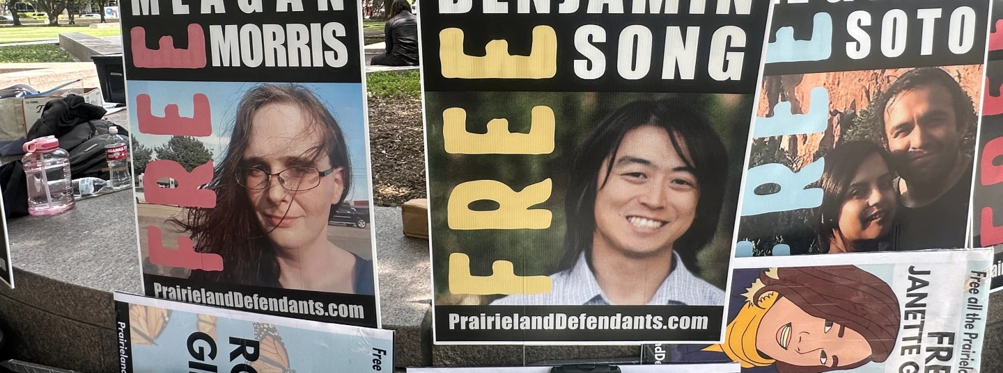
Cross Examination
Track effects on every defendant.
Avoid helping the government against your own client.
Notes:
Chris

Slide 22
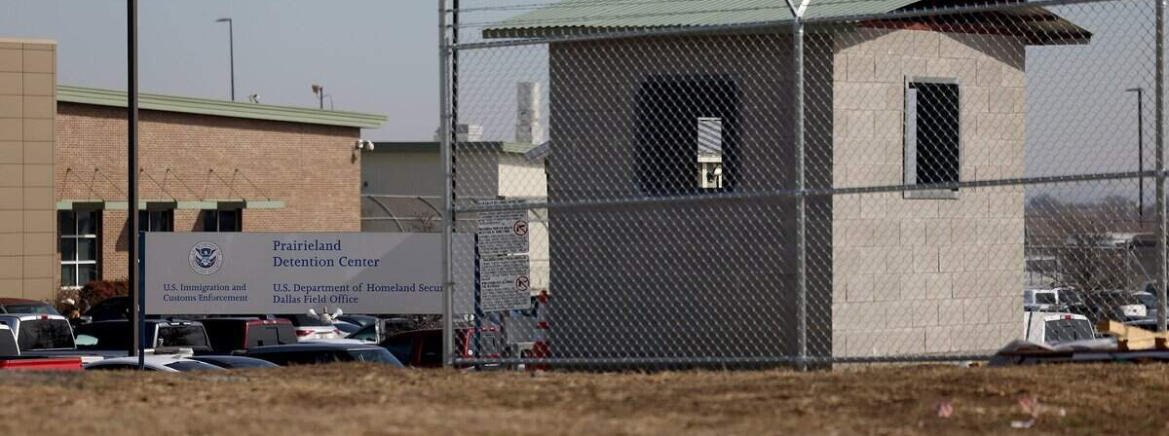
Rule 29
Attack sufficiency defendant-by-defendant.
Preserve issues for appeal.
Notes:
Chris

Slide 23
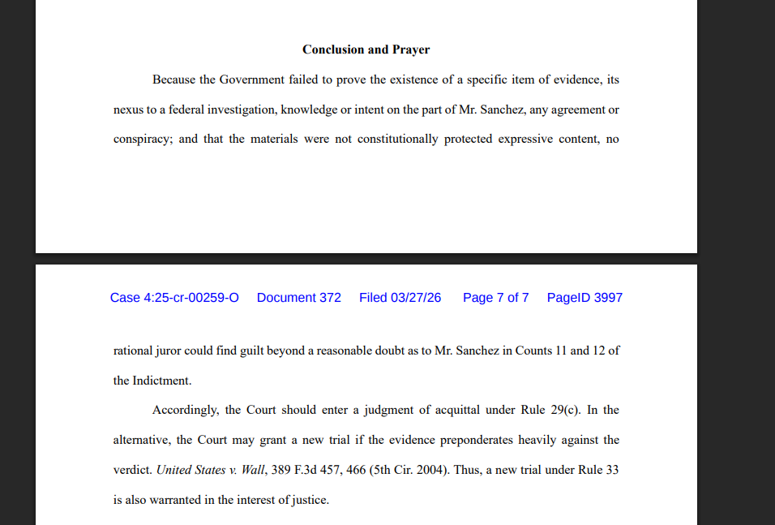
Notes:
Chris

Slide 24
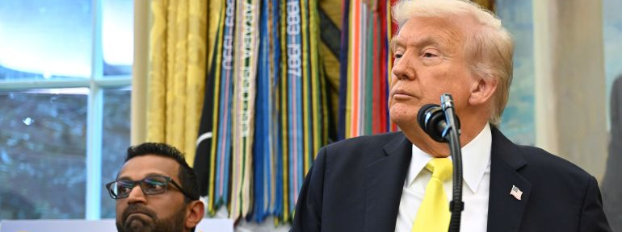
Closing
Bring jurors back to individualized proof.
Ask: What evidence actually proves THIS defendant's guilt?
Notes:
Chris

Slide 25
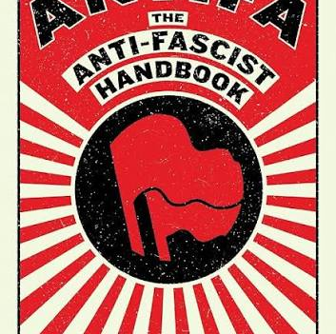
Lessons Learned
Every alliance is temporary.
Every strategic decision serves one client.
Adapt daily.
Protect the record.
Notes:
Rachel

Slide 26

Questions

