Slide 1


2026 FPD SUMMER SEMINAR
Protecting Every Day of
Your Client's Time
Mastering BOP Sentence Computations
Many players, one sentence — make every piece fit.
Gabriela Vega
Assistant Federal Public Defender | Dallas

Slide 2

THE STAKES
Every Day Counts
Lost credit is lost liberty. Not understanding credit computation can have real consequences for your client — months and even years of unintended incarceration.
A fair sentence is not automatic! YOU can make the difference by knowing what the rules say, when to ask for what, and who to pester when problems arise.
The right hand does not necessarily know what the left hand is doing. Thorny credit issues arise because so many players can be involved: the state court, state defense counsel, and the parole board; the federal judge, the USPO, and the USMS; and finally the BOP DSCC. You can be the one to make sure that the information flows to everyone involved.
Overserved time is banked (for revocations), not lost. There is still a point to fixing credit computations after the fact if your client is on supervised release after imprisonment.
Mastering BOP Computations
1

Slide 3

WHEN IS THE CLIENT GETTING OUT????
What does the federal judgment say?
What did the state do in its cases?
THE JUDGE
THE STATE
What’s the BOP’s information and interpretation?
What is the legal framework?
Mastering BOP Computations
5
Notes:
State Court If primary custodian can wipe away or preserve credit depending on primary custody is relinquished

Slide 4






PUTTING IT TOGETHER
From Judgment to Computation: USPO → USMS → BOP DSCC
FEDERAL JUDGE announces the system and issues the Judgement & Commitment order.
USPO Creates the file in the system, adding the PSR, Statement of Reasons, and Judgment & Commitment order.
USMS Takes over for review and processing — adds detainers, separation documents, state disposition records, and medical records; automatically releases a time-served federal judgment where applicable.
Release to State if it is the primary custodian to resolve pending matters or satisfy an undischarged state of imprisonment and places federal detainer
Obtains custody for the feds once the state relinquishes its primary custody and client is released on federal detainer
BOP DSCC (Grand Prairie) Reviews for sentence computation and facility designation, or issues a CRD/TRD release date if the client is within 120 days of completion.
Timing No computation or designation occurs until the client enters primary federal custody.
Mastering BOP Computations
14

Slide 5

THE FRAMEWORK
Relevant Statutes
18 U.S.C. § 3584 — Multiple Sentences. Governs imposition and administrative treatment of concurrent or consecutive terms, and the aggregation of sentences for computation.
18 U.S.C. § 3585 — Calculating the Term. Governs commencement of a federal sentence and allocation of prior-custody credit — including the rule that credit may not be awarded for time already credited to another sentence.
18 U.S.C. § 3621 & 28 C.F.R. § 0.96 — Custody & Designation. § 3621 authorizes commitment to BOP custody and BOP's authority to designate the place of imprisonment, including state facilities for concurrent service; § 0.96 delegates computation authority from the Attorney General to BOP.
18 U.S.C. § 3624 — Good Time. Establishes federal good-conduct time, up to 54 days per year for sentences over one year.
Mastering BOP Computations
4

Slide 6
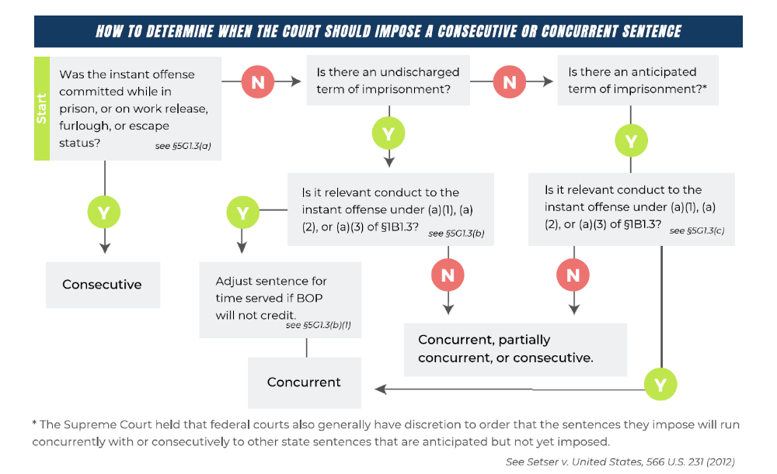
THE FRAMEWORK
USSG 5G1.3
Mastering BOP Computations
6

Slide 7

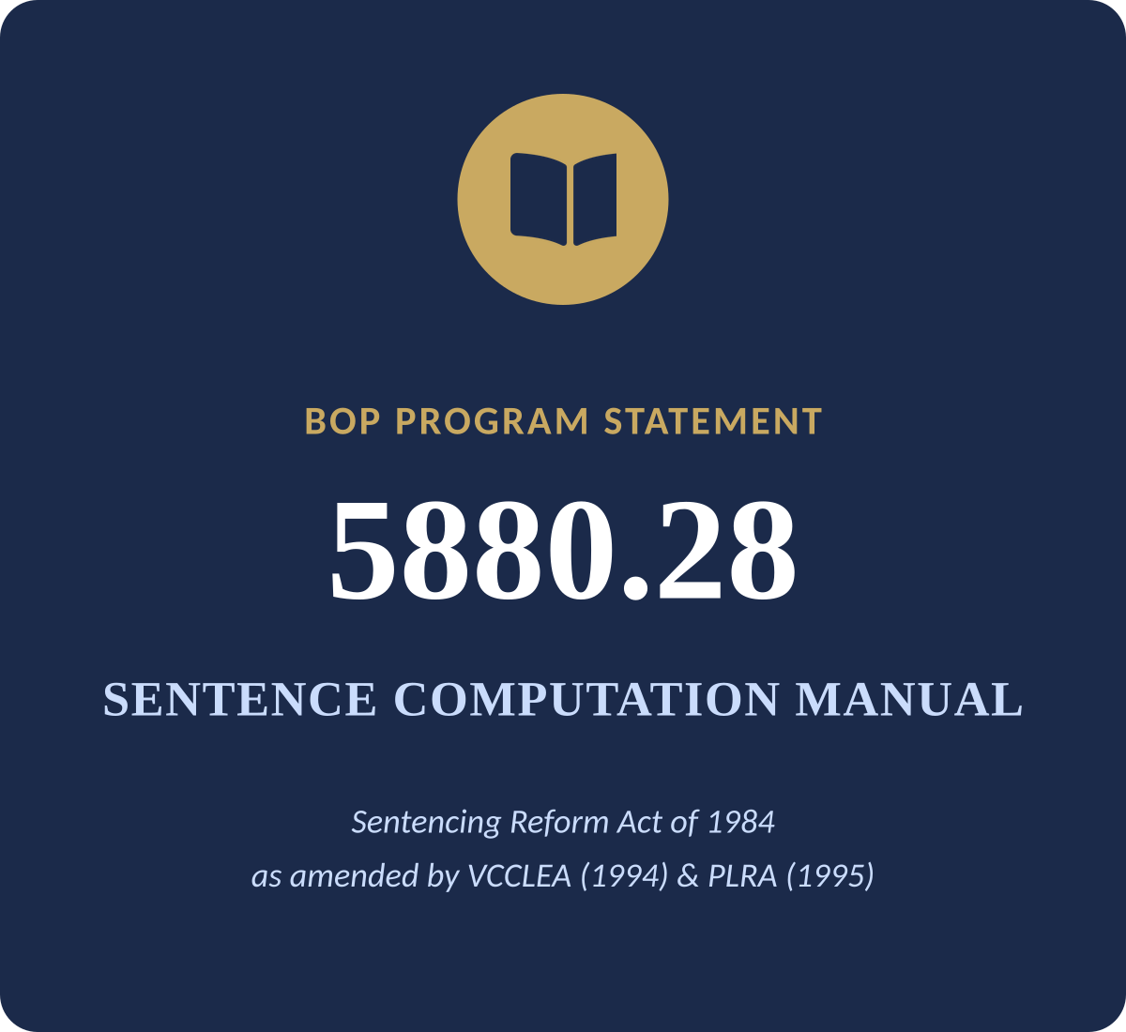
THE FRAMEWORK
Agency Publications
Notice of the Attorney General’s intention to exercise vested authority to designate or redesignate the place of a prisoner’s imprisonment shall be provided to the Bureau of Prisons as soon as practicable. Absent such notification, procedures for making classification, designation and redesignation decisions as described herein should be followed by the Bureau of Prisons.
Mastering BOP Computations
6

Slide 8

THE FRAMEWORK
Unlocking Credit
The sovereign that first obtains custody retains priority to exhaust its remedy before the other proceeds. The chief rule which preserves our two systems of courts from actual conflict of jurisdiction is that the court which first takes the subject-matter of the litigation into its control, whether this be person or property, must be permitted to exhaust its remedy, to attain which it assumed control, before the other court shall attempt to take it for its purpose. Ponzi v. Fessenden, 258 U.S. 254, 260 (1922).
Relinquishment: a writ of habeas corpus does NOT cut it. Bail, dismissal, parole, or satisfaction/expiration of sentence does.
  Causey v. Civiletti, 621 F.2d 691, 693 (5th Cir. 1980). “A writ of habeas corpus ad prosequendum is only a “loan” of the prisoner to another jurisdiction for criminal proceedings in the receiving jurisdiction.”
  United States v. Cole, 416 F.3d 894, 897 (8th Cir. 2005). Generally, a sovereign can only relinquish primary jurisdiction in one of four ways: 1) release on bail, 2) dismissal of charges, 3) parole, or 4) expiration of sentence.
NO DOUBLE DIPPING. Credit is awarded only for presentence detention that has not been credited against another sentence.
Only “official detention.” ICE detention does not qualify.
Mastering BOP Computations
5

Slide 9
THE FRAMEWORK
Unlocking Credit
Commencement of sentence. The clock starts when the defendant is received into custody at, or transported to, the designated facility for service. This is no earlier than when imposed, and may be if ordered consecutive and another sentence needs to be served first. Time spent waiting does not count.
Default is consecutive. If you want a sentence to run concurrent, you have to make sure to ask for it. The secondary custodian gets to decide this.
Judge decides sentence, BOP decides credit.
  United States v. Wilson, 503 U.S. 329 (1992). The Attorney General, through BOP, exclusively computes prior-custody credit — sentencing courts cannot award it.
  United States v. Taylor, 973 F.3d 414 (5th Cir. 2020). Confirms only BOP can compute credit or backdate commencement; a court that wants to account for presentence custody must reduce the sentence and state its reasons in the judgment.
  United States v. Madrid, 978 F.3d 201 (5th Cir. 2020). Courts cannot award prior-custody credit, but they may consider time spent in state custody when crafting the federal sentence.
  In re United States Bureau of Prisons, Dep't of Just., 918 F.3d 431, 439 (5th Cir. 2019). “[T]he district court must calculate the defendant's final sentence itself; it cannot simply order the BOP to award credit.”
Mastering BOP Computations
5

Slide 10

THE FRAMEWORK
Sentencing Discretion: What Courts Can (and Can't) Do
Can: order concurrent or partially concurrent terms with undischarged and anticipated state sentences.
Cannot: order concurrent or partially concurrent terms with discharged state sentences.
Can: consider time already spent in state custody, and the aggregate effect of multiple sentences, in crafting the sentence.
Cannot: award credit or backdate the commencement of a sentence.
Mastering BOP Computations
10

Slide 11
THE BOP
Safe assumptions
If your client was writed over, assume BOP will compute on the assumption that the state held primary custody. It is on you to determine relinquishment if it happened and make sure the file correctly reflects it.
If a state court judgment credited time to a state sentence, that time is not available for service of federal sentence. Right or wrong, computation will see that time and not credit it against your federal judgment.
The imprisonment number on the face of the judgment, if coupled with adjustment language, may mean something different to BOP. The BOP is not looking to do your client any favors, that is not their role. They will interpret the judgment as they see fit. I have seen BOP use a different number from what appears on the face of the judgment twice, both to the detriment of the client.
The no double-credit rule will be followed in all instances. But if all else fails, I wanted to point out two exceptions that you can point out to the BOP in a last-ditch effort to get some time back for your client.
Mastering BOP Computations
9

Slide 12
THE BOP
Willis Credit
Willis v. United States, 449 F.2d 923 (5th Cir. 1971) — BOP describes Willis credit as an "effectual benefit" exception to § 3585(b)'s no-dual-credit rule, awarding credit for qualified state prior-custody time. See BOP PS 5880.28, pp. 1-21 to 1-24A.
1
Concurrent sentences: are the federal and state sentences ordered to run concurrently?
2
Federal offense date: did the non-federal presentence custody begin on or after the federal offense date?
3
Timing of custody: does the custody period occur before the start of the first sentence?
4
Raw full-term dates: is the state raw EFT equal to or less than the federal raw EFT?
5
No double credit: has the time not already been credited toward the state sentence, except as the Willis rule allows?
Mastering BOP Computations
12

Slide 13
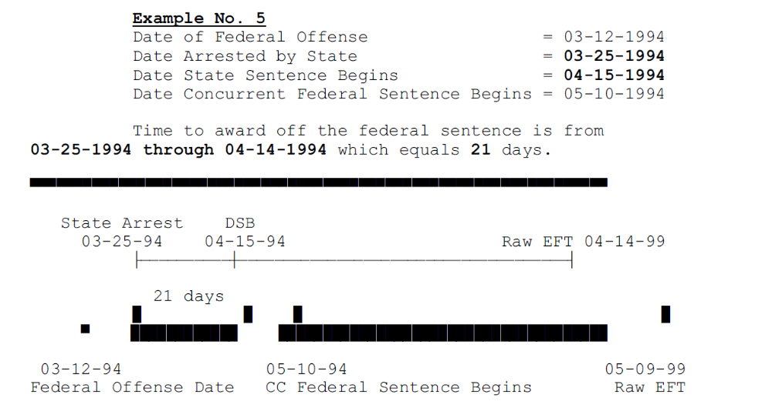

Slide 14
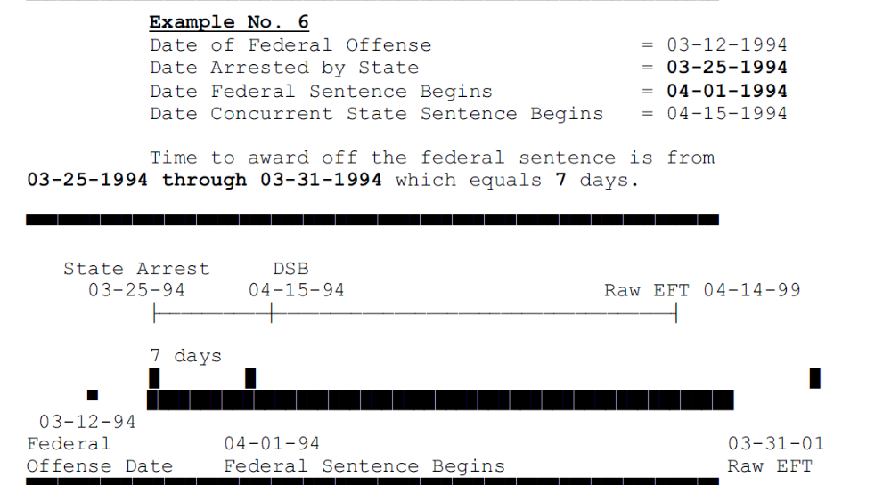

Slide 15
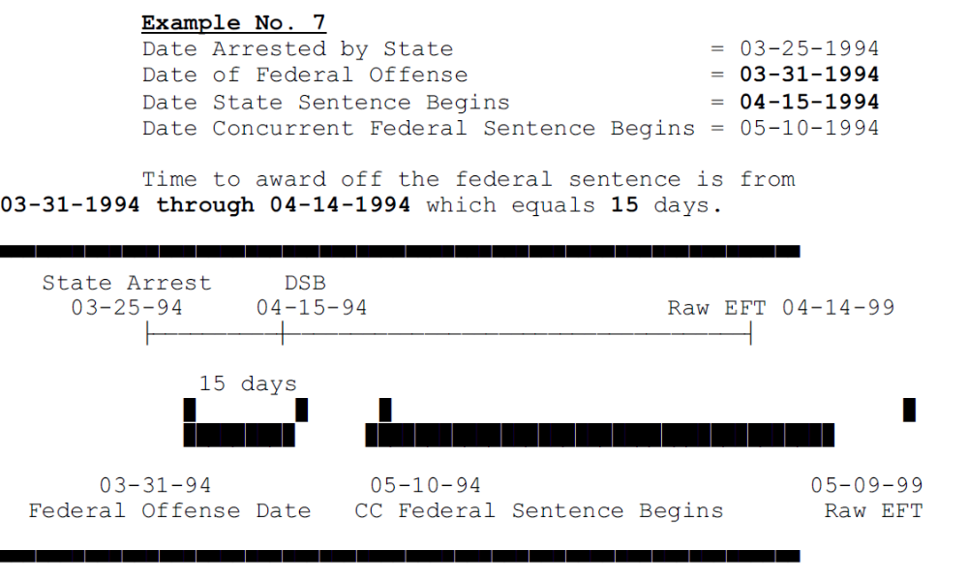

Slide 16
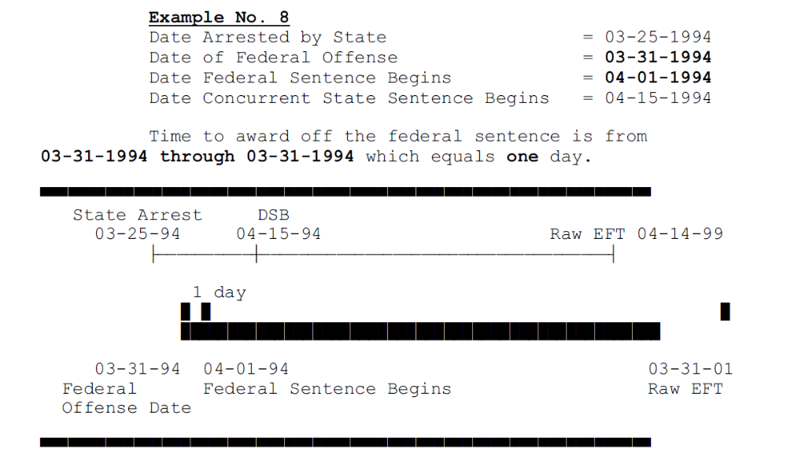

Slide 17
THE BOP
Kayfez Credit
Kayfez v. Gasele, 993 F.2d 1288 (7th Cir. 1993) — credit applied toward the federal sentence so that the effective full-term dates "line up."
1
Concurrent sentences: are the federal and state sentences ordered to run concurrently?
2
State EFT greater: is the initial state raw full-term date greater than the federal raw EFT?
3
Qualified time: can qualified non-federal presentence custody time be applied to the state sentence?
4
Adjusted state EFT: does applying that time make the adjusted state EFT earlier than the federal raw EFT?
5
Federal adjustment: can the federal raw EFT be reduced to match the earlier, adjusted state EFT?
Mastering BOP Computations
13

Slide 18
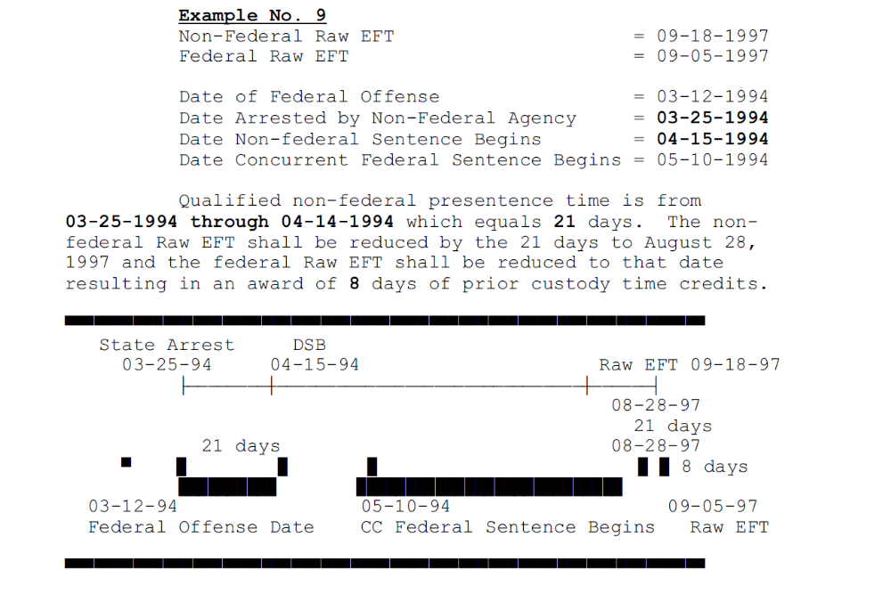

Slide 19
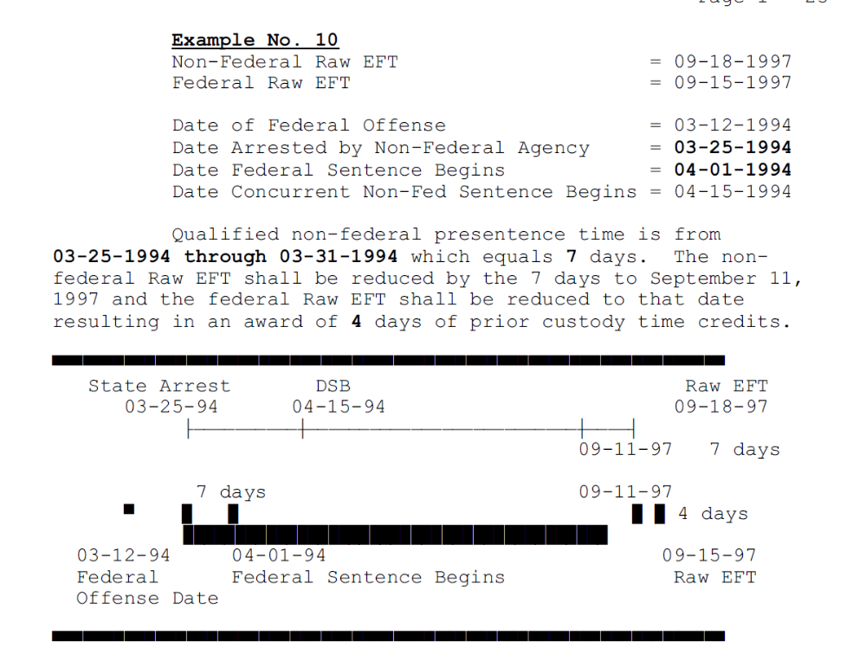

Slide 20
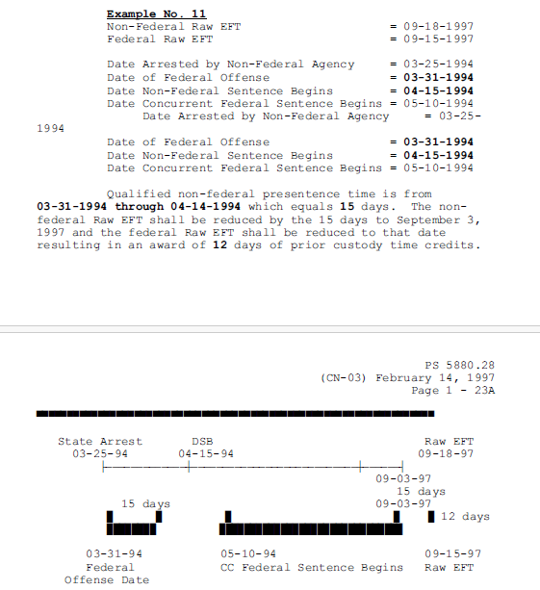

Slide 21
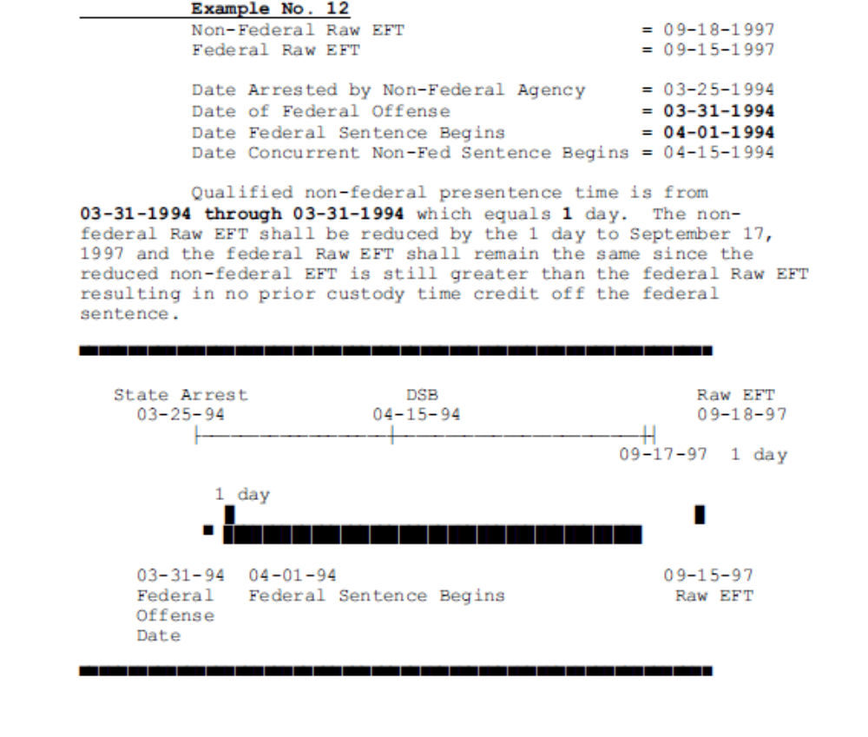

Slide 22
Real Case Examples

Slide 23
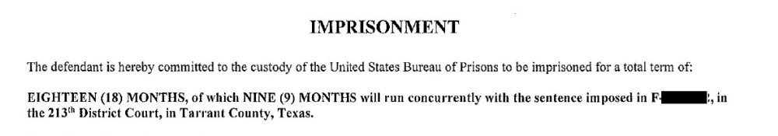

Slide 24
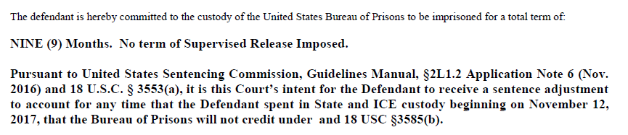

Slide 25
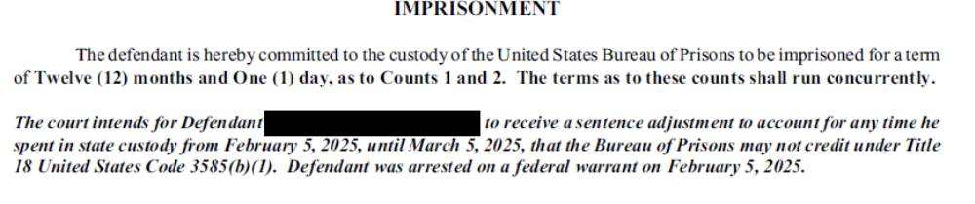

Slide 26
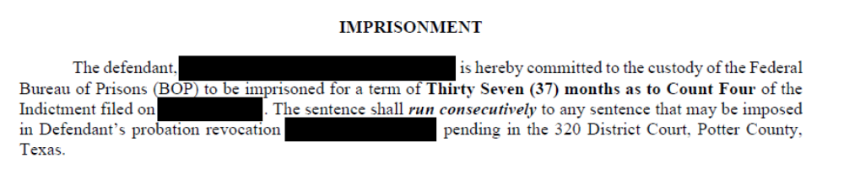

Slide 27



PRACTICE POINTERS
Early in the Case
Build a custody timeline Include arrest dates, bond dates, sentence dates, credit dates, and anticipated sentence-expiration dates.
Determine custodians Identify the primary and secondary custodian.
Evaluate a custody swap The primary custodian's time is served first — this decides whether your client does that stretch in a federal or state facility.
Mastering BOP Computations
17

Slide 28
PRACTICE POINTERS
Before Sentencing Materials Are Due
Check pending matters. Confirm the status of any pending cases or revocation proceedings — ask the client directly and check available dockets for relinquishment since you last did your custody determinations.
Reassess custody status. Confirm whether primary or secondary custodian status has changed based on developments.
Sort relevant conduct. List all other cases and determine which qualify as relevant conduct and which should be run concurrent under the guidelines. This can be a strategic call turning on offense-level triggers, sentence length, and criminal history category. Make sure to ask for a concurrent sentence under the guidelines.
Prepare your ask. Decide what sentencing options to present, and have adjustment language ready.
Mastering BOP Computations
18

Slide 29
PRACTICE POINTERS
At and After Sentencing
At sentencing. Clarify the judge's intent as precisely as possible on the record, and consider calculating an anticipated release date to head off any BOP interpretation disputes.
Follow up. If you requested an adjustment, proactively confirm BOP is interpreting the language as intended — the sentencing transcript can resolve disagreements.
Coordinate. Work with state defense counsel, especially where some pending cases were run concurrent and others consecutive.
Stay engaged. Overserved time is banked time (for revocations), not lost time. I also have gotten BOP to change its mind before. It’s not all lost.
Mastering BOP Computations
19

Slide 30
MAKING YOUR ASK
Drafting the Adjustment
The judge's duty. Do not let the judge wash his or her hands of any credit issues because “that’s BOP’s job.” Make the court engage with credit issues directly — through § 3553(a)'s mandate that the sentence be "sufficient, but not greater than necessary," and through USSG § 5G1.3. BOP cannot adjust sentences; that authority belongs exclusively to the sentencing judge. Figuring out credit has to be done “here and now,” not after the fact.
Rule 1 — Name it. Specify concurrent or consecutive service by case name and number.
Rule 2 — Show your work. If granting an adjustment, cite § 5G1.3, calculate the amount, and spell out exactly how the sentence's effect was determined.
Rule 3 — Watch your language. Never use the phrase "credit for time served" — request an adjustment instead.
Mastering BOP Computations
20

Slide 31
MAKING YOUR ASK
Example: Judgment, United States v. Taylor
No. 5:18-cr-00153-SMH-MLH (W.D. La. Apr. 12, 2021), ECF No. 57 — on remand after 973 F.3d 414 (5th Cir. 2020)
The history. Taylor was initially sentenced to 120 months, with the judgment stating the sentence would run concurrently with any state sentence for the same conduct and that he would receive credit for time served from July 9, 2018.
The reversal. The Fifth Circuit vacated, holding the district court lacked authority to backdate the sentence or award credit — that authority is reserved to BOP under § 3585(b) — and remanded for the court to clarify its intent.
“The defendant is hereby committed to the custody of the Federal Bureau of Prisons to be imprisoned for a total term of: 120 months minus 44 months as to Count One, to commence immediately. Thus, the total sentence is 76 months. This sentence reflects a downward departure of 44 months pursuant to USSG Sections 5K2.23 and 5G1.3 Application Note 5.”
Mastering BOP Computations
22

Slide 32
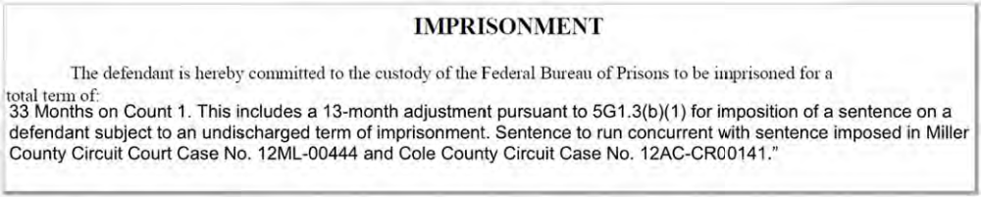
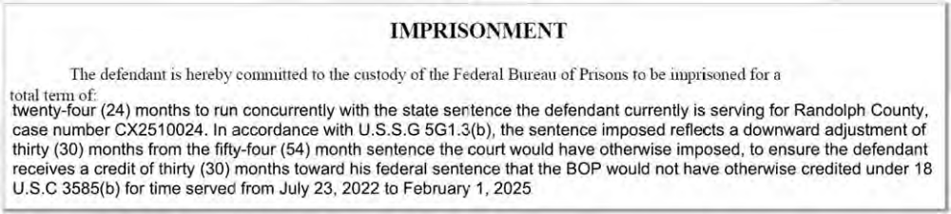
MAKING YOUR ASK
Other Examples
Mastering BOP Computations
23

Slide 33
MAKING YOUR ASK
Other Examples
Pursuant to United States Sentencing Commission, Guidelines Manual, §5G1.3, it is the Court's intent for the sentence to run concurrently with any sentence imposed in the defendant's pending cases of [identify pending cases], and for the defendant to receive a sentence adjustment to account for any time spent in custody beginning on [specific date], that the Bureau of Prisons will not credit under 18 U.S.C. §3585(b). If the Court could order the sentences to run fully concurrently, it would, so it is the Court's intention that the effect be the same as if the federal sentence ran concurrently from the date service of the state sentence began, including any time credited by the state court towards the state sentence.
This sentence shall run consecutively to any sentence imposed in Case No. F1956711 pending in the 194th Judicial District Court of Dallas County as it is unrelated to the instant offense. In the event the sentences in Case No. F1957648 and Case No. F1956711 are run concurrently with each other, this sentence shall run concurrently with the sentences imposed.
Mastering BOP Computations
23

Slide 34
COMPLETING THE PUZZLE
Practitioner Checklist
Early Assessment
Sentencing Strategy
Post-Sentencing
Build a custody timeline; identify primary/secondary custodian
Evaluate a custody swap
Confirm status of pending cases and revocations
Reassess custody status before sentencing
Sort relevant conduct vs. concurrency candidates
Ready your ask – it’s not “credit for time served,” it’s an adjustment. Cite §5G1.3 (if applicable). Show your work!
Clarify intent on the record; calculate anticipated release date if you can
Confirm BOP's computation matches the court's intent
Use the transcript to resolve disagreements
Coordinate with state defense counsel to make sure any pleas/sentences there are with those deemed concurrent in the federal judgment
If you think there is an issue, don’t lose hope! Keep pestering
Mastering BOP Computations
24

Slide 35

COMPLETING THE PUZZLE
Keep the information flowing
USMS – Kelly Gutierrez | Lead Investigative Analyst | Desk 214-767-0836 ext. 273 |Work Cell (213) 798-5071 |Kelly.Gutierrez@usdoj.gov
BOP – GRA-DSC-TeamKilo-S@bop.gov (clients sentenced in N.D. Texas)
  GRA-DSC/PolicyCorrespondence@bop.gov (recommended by SRC for sentence reduction orders)
  BOP-CPD-DSC-PolicyCorrespondence-S@bop.gov; (972) 352-4400; fax (972) 352-4395 (recommended for amended judgments)
DOJ-361. Can help prompt BOP designation and calculation staff to disclose case-specific information.
USMS 129 Custody Report. Unclear whether you can obtain it, but I have (perhaps mistakenly) to get the custody timeline of a client.
PPPI. Obtainable in many cases without a DOJ-361, simply by providing your name, the appointment order, and identifying the case. This is the main BOP computation document.
Mastering BOP Computations
16

Slide 36

COMPLETING THE PUZZLE
What to Remember
Primary custodians get their sentences served first, secondary custodians decide concurrent/consecutive.
Things change; stay up to date, especially as sentencing approaches
BOP computes; the judge decides — build the credit issue into the sentence request itself. Request an “adjustment,” not “credit for time served.” Know specifics and show your work.
Keep the flow of information so that the information sent to BOP is complete
The work may not end at sentencing; follow up with BOP/USMS with after the fact developments and coordinate with state counsel as needed
Mastering BOP Computations
25

Slide 37
Questions?
gabriela_vega@fd.org

